Slide 1
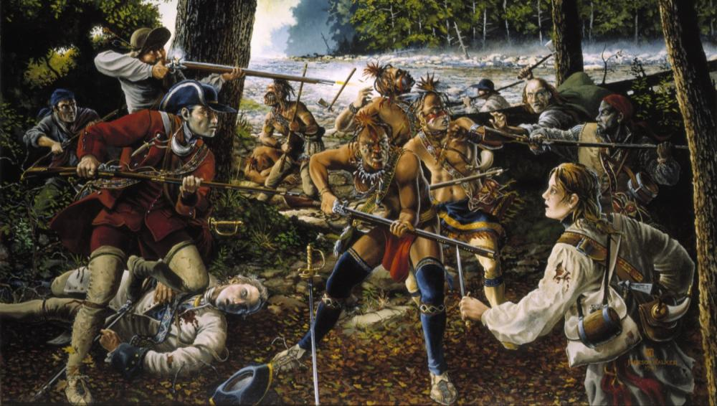
French and Indian War
Europe’s Seven Years War!
Truly the First WORLD WAR
Notes:
Painting from the National Guard’s Historical Paintings, Heritage Series available from http://www.ng.mil/resources/photo_gallery/index.html?lib=heritage/index.htm

Slide 2
Interactive Menu
Causes of the War
Background
Events Leading to War
Leaders and Battles
Immediate Outcome
Why It Matters Now

Slide 3
Causes of the War

Slide 4
Britain and France
The conflict known as the Seven Years’ War in Europe and the French and Indian War in America developed over a long period.
It had roots in a struggle between Britain and France that had been going on for nearly 200 years.
The struggle stemmed from each nation’s
position in European power politics
pursuit of mercantilism
global expansion
The Anglo-French rivalry often erupted into military conflicts.

Slide 5
Competing Goals
French Goals:
British Goals:
Control as much territory as possible
Dominate Europe politically and economically
Maintain their own political and economic power
Control as much territory as possible
Conflict!

Slide 6
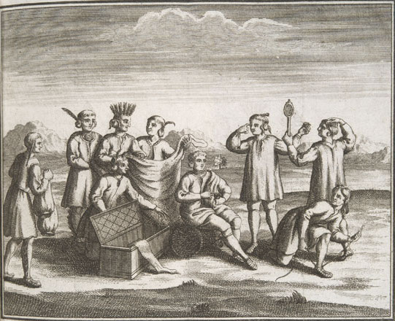
Colonists, Indians, and Fur
Colonial American fur traders from Pennsylvania and Virginia wanted to trade with native tribes in the Ohio River Valley.
However, French colonists had long claimed the Ohio Valley as part of New France.
The fur trade also magnified animosity between American Indian tribes who competed with one another for territorial dominance.
Notes:
Image: Colonists and American Indians trading goods.

Slide 7
Background

Slide 8
Confusing Name for a War
The struggle between Britain and France and their European allies can explain much of the Seven Years War, as it was called in Europe.
Nevertheless, a large part of the fighting actually took place in North America.
The war even started about 2 years earlier in North America than it did in Europe.
The fighting began in the Ohio River Valley in 1754 and it didn’t spread to Europe until 1756.
Using the earlier date, it could have been called the Nine Years War.
In America, however, the war was not known as the Seven Years War.

Slide 9
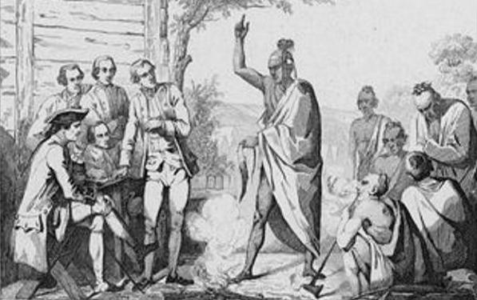
Confusing Name For a War
In America, the war became known as the French and Indian War.
The American name for the war reflected the local focus that colonists had on the events of the war.
For American colonists, it would be remembered as the war in which they fought the French and (most of) the Indians; not as the vast war for empire known in European history as the Seven Years War.
Notes:
Image: French and Indian Leaders holding a conference.

Slide 10
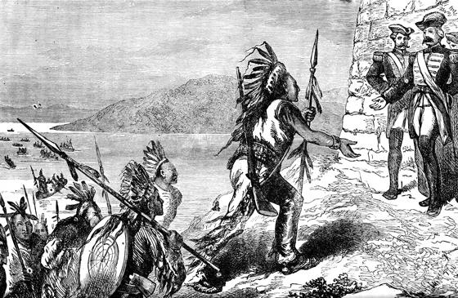
Choosing Sides
American Indians played a major role on both sides of this conflict.
They were not bystanders caught in the crossfire.
Instead, they were willing participants with motives of their own.
In order to fully understand those motives, it is important to examine the interactions between colonists and the indigenous tribes in America prior to the war.
Notes:
Image: Indian allies arrive at a French camp.

Slide 11
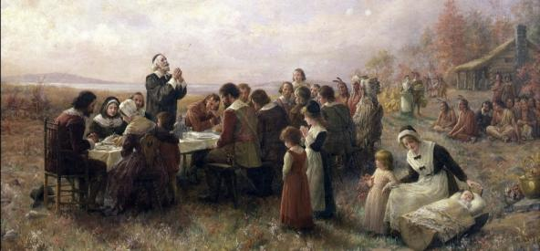
Native Tribes & the English
A short period of friendship between English colonists and native tribes followed the initial settlements in Virginia and Massachusetts.
However, tension soon arose, usually due to conflict over land:
English colonial populations quickly grew;
They set up permanent settlements, cleared the land, built large farms and towns and cities;
This tended to come into conflict with tribal land use patterns.
The tribes soon realized that the English settlers’ plans involved eventually moving them out, one way or another.
Notes:
Image: The First Thanksgiving at Plymouth by Jennie A. Brownscombe. (1914)

Slide 12
Native Tribes & the French
The French, in contrast, were more interested in doing business with the Indians than pushing them out of the area.
They were especially interested in the extremely profitable fur trade.
The Indians supplied the furs in exchange for tools, weapons, and brandy.
From a business standpoint, it would not have made sense to anger the Indians by occupying their land.
Unlike farmers, fur traders did not need much land anyway.

Slide 13
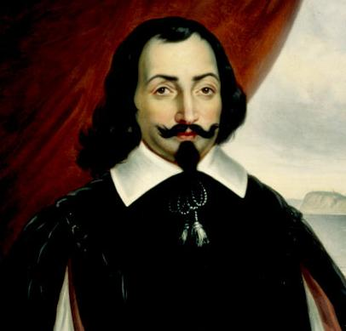
Native Tribes & the French
Therefore, the French left a much smaller footprint on the land than their British counterparts:
There were about 60,000 French settlers in North America in 1754.
By contrast, there were over a million British colonists in North America by 1750.
The French were also willing to assist their trading partners in armed conflicts against rival tribes.
In 1609, Samuel de Champlain and 4 others joined Algonquin and Huron Indians in a campaign against the Iroquois.

Slide 14
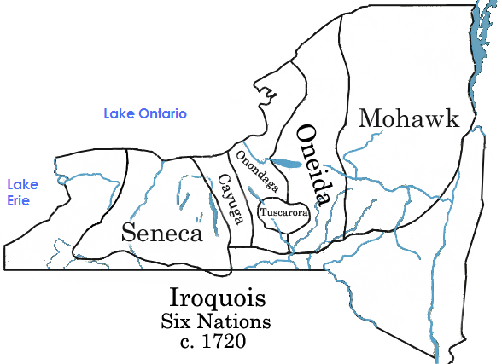
The Iroquois
The exception to this pattern of cooperation with the French was the Iroquois Confederation.
The Confederation was a group of 6 tribes;
Collectively, they formed most powerful American Indian group in Eastern North America.
Smaller tribes saw the Iroquois as a threat long before the British and French arrived on the scene.
Sporadic fighting and warfare between the Iroquois and other tribes were common occurrences.

Slide 15
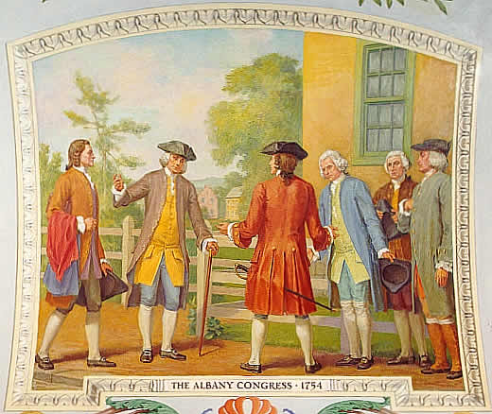
Francophobe Iroquois
The Iroquois saw the French as an enemy because
They had had some clashes with early French explorers;
the French were always willing to defend their trading partners in the smaller tribes.
The Iroquois tribes also had commercial relations with the British and sided with the British Crown during the war.
They proved to be a powerful ally.
In 1754, delegates from 7 colonies met with leaders of the Iroquois Confederacy to convince them to join the effort to curb France’s domination of the fur trade.

Slide 16
Events Leading to War

Slide 17
Events Leading to War
In 1749, some prominent Virginia planters formed the Ohio Company.
They were interested in claiming the region as part of the Virginia colony*.
With the support of English financers, they received a royal grant of 200,000 acres in the Ohio River Valley.
The French quickly moved troops in to protect the territory from British and American land speculators and fur traders.
Notes:
*Ironically, both Pennsylvania and Virginia claimed the land as part of their respective colonies, within the British Empire.

Slide 18
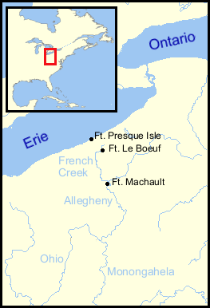
Events Leading to War
In 1753, the French began building a series of forts along the Allegheny River.
The British government ordered colonial governors to resist the French advance, "by force" if necessary.
Virginia Governor Robert Dinwiddie sent a 21 – year – old George Washington to Fort Le Boeuf.
His mission: Warn the French to leave the area.

Slide 19
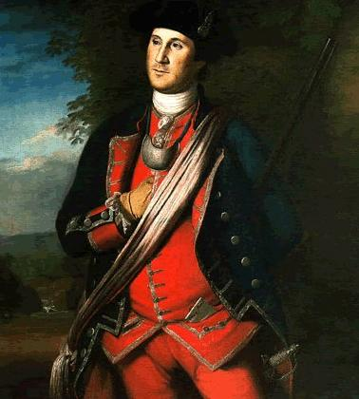
George Washington
George Washington has the well-earned reputation as the Father of the United States.
Without question he set the standard for all presidents who followed him.
Without his valor as general, there would most likely never have been an independent United States.
The future rebel general began his military career in the Virginia militia, where he earned a reputation for extreme bravery.
Ironically, his reputation for courage came after the young Washington made some major military mistakes in 1754.

Slide 20
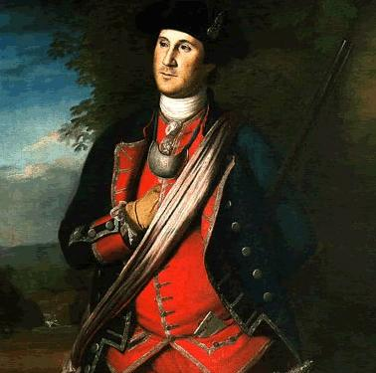
Washington’s First Command
Washington left Williamsburg in late 1753 with an 8 – man party to deliver the warning.
They travelled hundreds of miles through the wilderness to the proximity of modern Erie, Pennsylvania.
The French refused to leave and sent Washington back to Virginia.
Before Washington returned, a small Virginia force was sent to build Fort Prince George at the fork where the Allegheny, Monongahela, and Ohio Rivers meet*.
Notes:
*present-day Pittsburgh

Slide 21
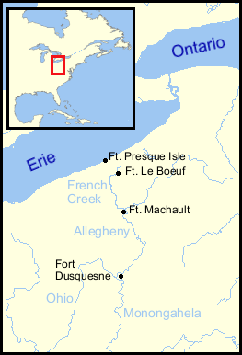
Fort Duquesne
Washington’s report caused quite a stir in Virginia and England.
Governor Dinwiddie sent Washington back to the area; this time his objectives were
to solidify Virginia’s claim to the Ohio territory;
help defend Fort Prince George.
Before Washington arrived, a French force had captured the incomplete fort and built Fort Duquesne in its place.

Slide 22
Jumonville Glen May 28, 1754
After learning that the French now controlled the fort, Washington decided to set up camp at a clearing known as Great Meadows.
A small French force under command of Ensign Joseph Jumonville was sent from Fort Duquesne to intercept Washington’s party.
A Seneca chief and British ally named Tanaghrisson warned Washington of the approaching French troops.

Slide 23
Jumonville Glen May 28, 1754
Tanaghrisson persuaded the young Washington to ambush the French, which he did on the morning of May 28, 1754.
The French called for a ceasefire, but according to some accounts, Tanaghrisson ended any chance for a peaceful solution by killing Jumonville brutally with a tomahawk*.
Realizing that more French troops would soon arrive, Washington ordered his men to return to Great Meadows where they constructed the aptly named Ft. Necessity.
Less than a month later, Washington and his men were indeed attacked by a much larger French force.
Notes:
*According to historian Fred Anderson, this is the most probable account. Historians have also hypothesized that Tanaghrisson’s plan was probably to put the British in a position where they would have to maintain their alliance with the Iroquois and drive out the French and other non-Iroquois tribes from the area, which the Iroquois wanted for themselves.

Slide 24
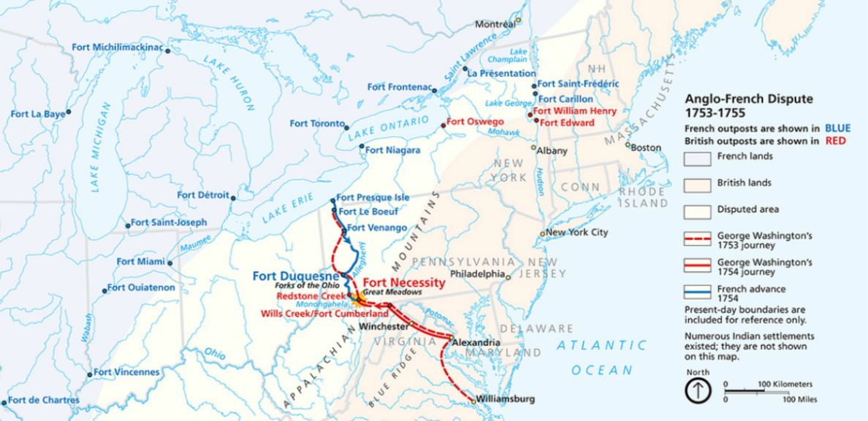
Leaders and Battles
The North American Theater

Slide 25
Three Phases of the War
Phase 1 1754 – 1756 | Phase 2 1756 – 1758 | Phase 3 1758 – 1763
Local actions in North America beginning with Fort Necessity; Most action is about trying to capture frontier forts; The British are largely unsuccessful. | Begins with a real declaration of war (May15, 1756); Touches off a true world war (Seven Years War); Both sides commit more men and resources. | Britain decides to concentrate on North America; Britain invests HUGE amounts of money; Ends with British victory.

Slide 26
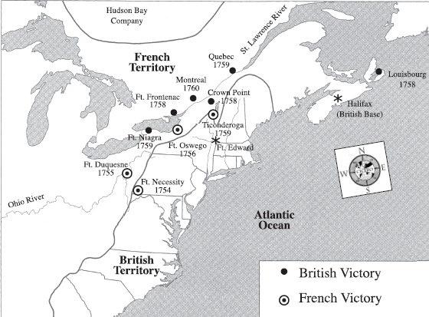
Fort Necessity/Great Meadows July 3, 1754
Phase 1
When word of Jumonville’s death reached Fort Duquesne, a party of 600 French, Canadian, and Indians set out to attack Washington’s force on June 28, 1754.
They reached Fort Necessity on July 3rd.
Although he and his men fought valiantly, Washington was soon forced to surrender.
The surrender document, written in French, contained a confession to the murder of Ensign Jumonville*.
Notes:
*Washington did not speak French, so he probably did not know he was confessing to the murder.

Slide 27
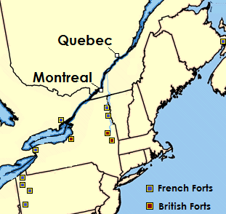
The British Plan of Attack
Phase 1
Authorities in England were not going to let the French attack on Fort Necessity go unanswered.
In 1755, they launched a 4-pronged plan:
General Edward Braddock would lead an attack on Ft. Duquesne;
Lt. Col. Robert Monckton would lead an attack on Ft. Beausejour;
Sir William Johnson would lead an attack on Ft. St. Frederic;
Massachusetts Governor William Shirley would fortify Ft. Oswego, then lead an attack on Ft. Niagara.
Beausejour
St. Frederic
Oswego
Niagara
Duquesne

Slide 28
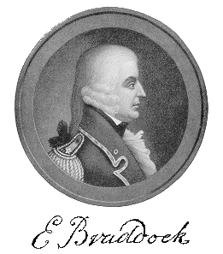
General Braddock Arrives
Phase 1
General Braddock brought 2 regiments to America, which he planned to supplement with provincial recruits.
Braddock also needed a guide to lead the way, a position well suited to Lt. Col. George Washington.
On May 29, 1755, Braddock and Washington set out from Maryland to capture Fort Duquesne with a force of 1,500 British troops and Virginia militia.

Slide 29
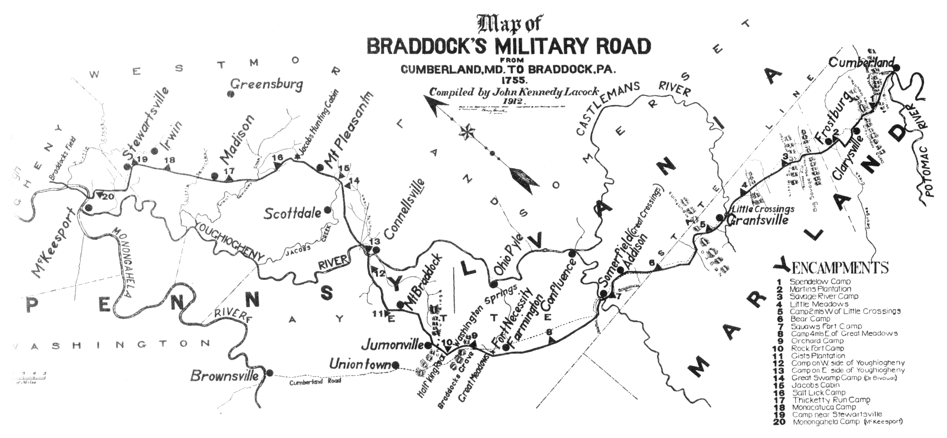
Monongahela July 9, 1755
Phase 1
Braddock assumed the mere sight of British regulars would cause panic among the French and their indigenous allies.
Washington warned that they should expect guerilla warfare from the enemy.
Braddock, however, stubbornly refused to believe that the French would fight anything other than a European-style battle.
Braddock’s column crossed the Monongahela River on July 9, 1755.

Slide 30
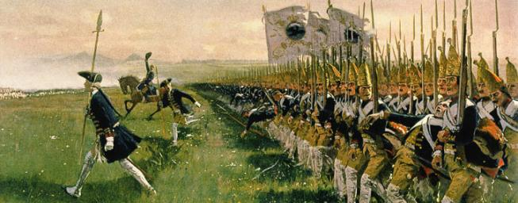
Linear Warfare
Guerilla Warfare
Europeans fought in line formation.
This tactic was used because the guns were so inaccurate that soldiers had to fire at the same time in order to inflict casualties.
After firing 4 – 5 shots, soldiers would affix their bayonets and fight hand to hand with the enemy line.
Soldiers who engage in Guerilla Warfare rely heavily on the element of surprise.
American colonists usually fought in the European style.
However, they learned Guerilla tactics from American Indians during the French and Indian War.
American Indians often used ambushes, or sneak attacks, to catch the enemy off guard.
The British regarded such tactics as dishonorable.

Slide 31
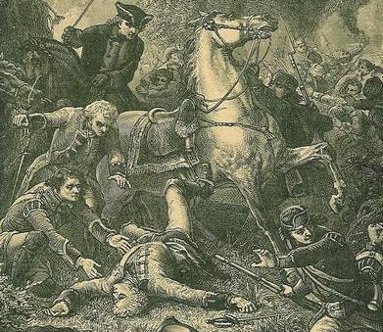
Monongahela July 9, 1755
Phase 1
As Washington had predicted, lead elements of the column were attacked immediately.
British troops were trapped in a ravine; panic quickly ensued.
Casualties were extremely high and Braddock was killed while rallying his men.
Washington assumed command and made a hasty retreat.
Before he died, Braddock promised to make Washington an officer in the British Army. Washington, however, was blamed for the defeat and denied the commission.

Slide 32
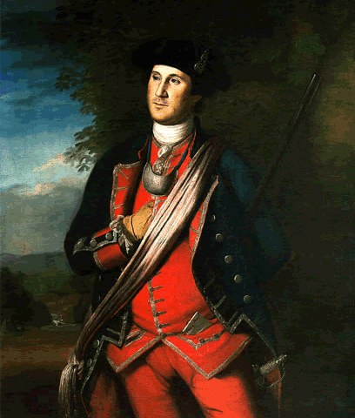
Monongahela July 9, 1755
Phase 1
Despite the failure of the mission, Washington was hailed as a hero:
Colonists knew that 60% of the officers and enlisted men were killed or wounded;
They also knew that it was Washington who led the survivors safely back to Virginia.
His fame spread quickly throughout the colonies:
As a result of his western exploits, Washington became the best known American in all 13 colonies, other than Ben Franklin.

Slide 33
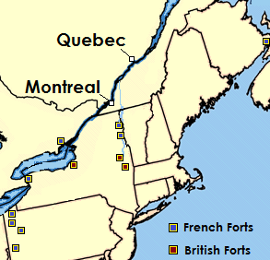
Shirley & Johnson
Phase 1
Inexperienced and disorganized, Governor Shirley never made it to Fort Niagara.
By late August, Johnson and his men were camped at Fort Edward, preparing for their attack on Fort St. Frederic.
Johnson defeated a French force led by Baron Dieskau near Lake George, but never took Fort Saint Frederick.
Beausejour
St. Frederic
Lake
George
Ft. Edward
Monkton’s attack against Beausejour would become the only true strategic victory of 1755*.
Notes:
*The capture of Fort Beausejour cut the French fortress at Louisbourg off from the mainland. This event also marked the beginning of Britain’s “Expulsion of the Acadians” in which French settlers from present-day New Brunswick, Prince Edward Island, and Nova Scotia were deported. Many Acadians eventually migrated to French Louisiana. Descendants of those migrants are considered a distinct ethnic group known as “Cajuns.”

Slide 34
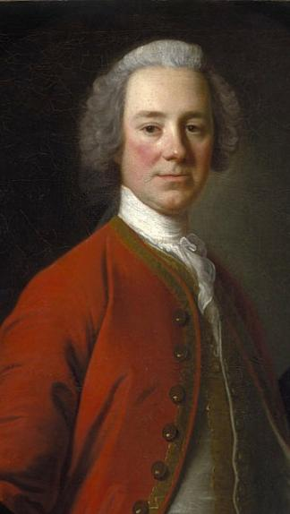
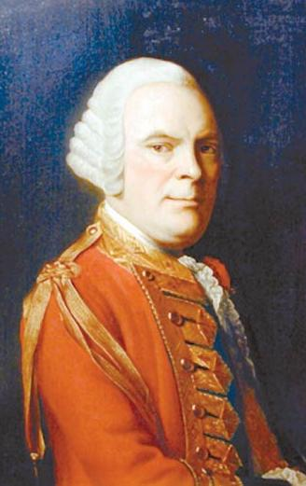
A Declaration of War
Phase 2
On May 15, 1756, England officially declared war on France and its allies.
Now, fighting would take place in Europe, India, and on the high seas, as well as in North America.
General John Campbell was given command of British forces in North America.
Despite more funding and troops, the British continued to loose battles in the North American theater.
Unpopular and unsuccessful, John Campbell (left) was replaced by General James Abercrombie (right) in 1758.

Slide 35
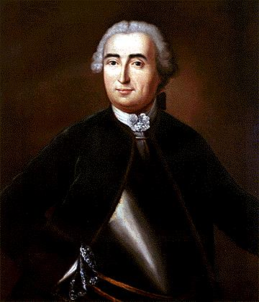
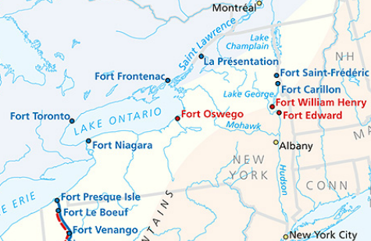
Louis-Joseph de Montcalm
Phase 2
General Montcalm arrived in Montreal in May of1756 to take command of French forces in North America.
Montcalm first reinforced defenses at the newly built Fort Carillon on Lake Champlain.
He then launched a successful attack against Fort Oswego in August of 1756.

Slide 36
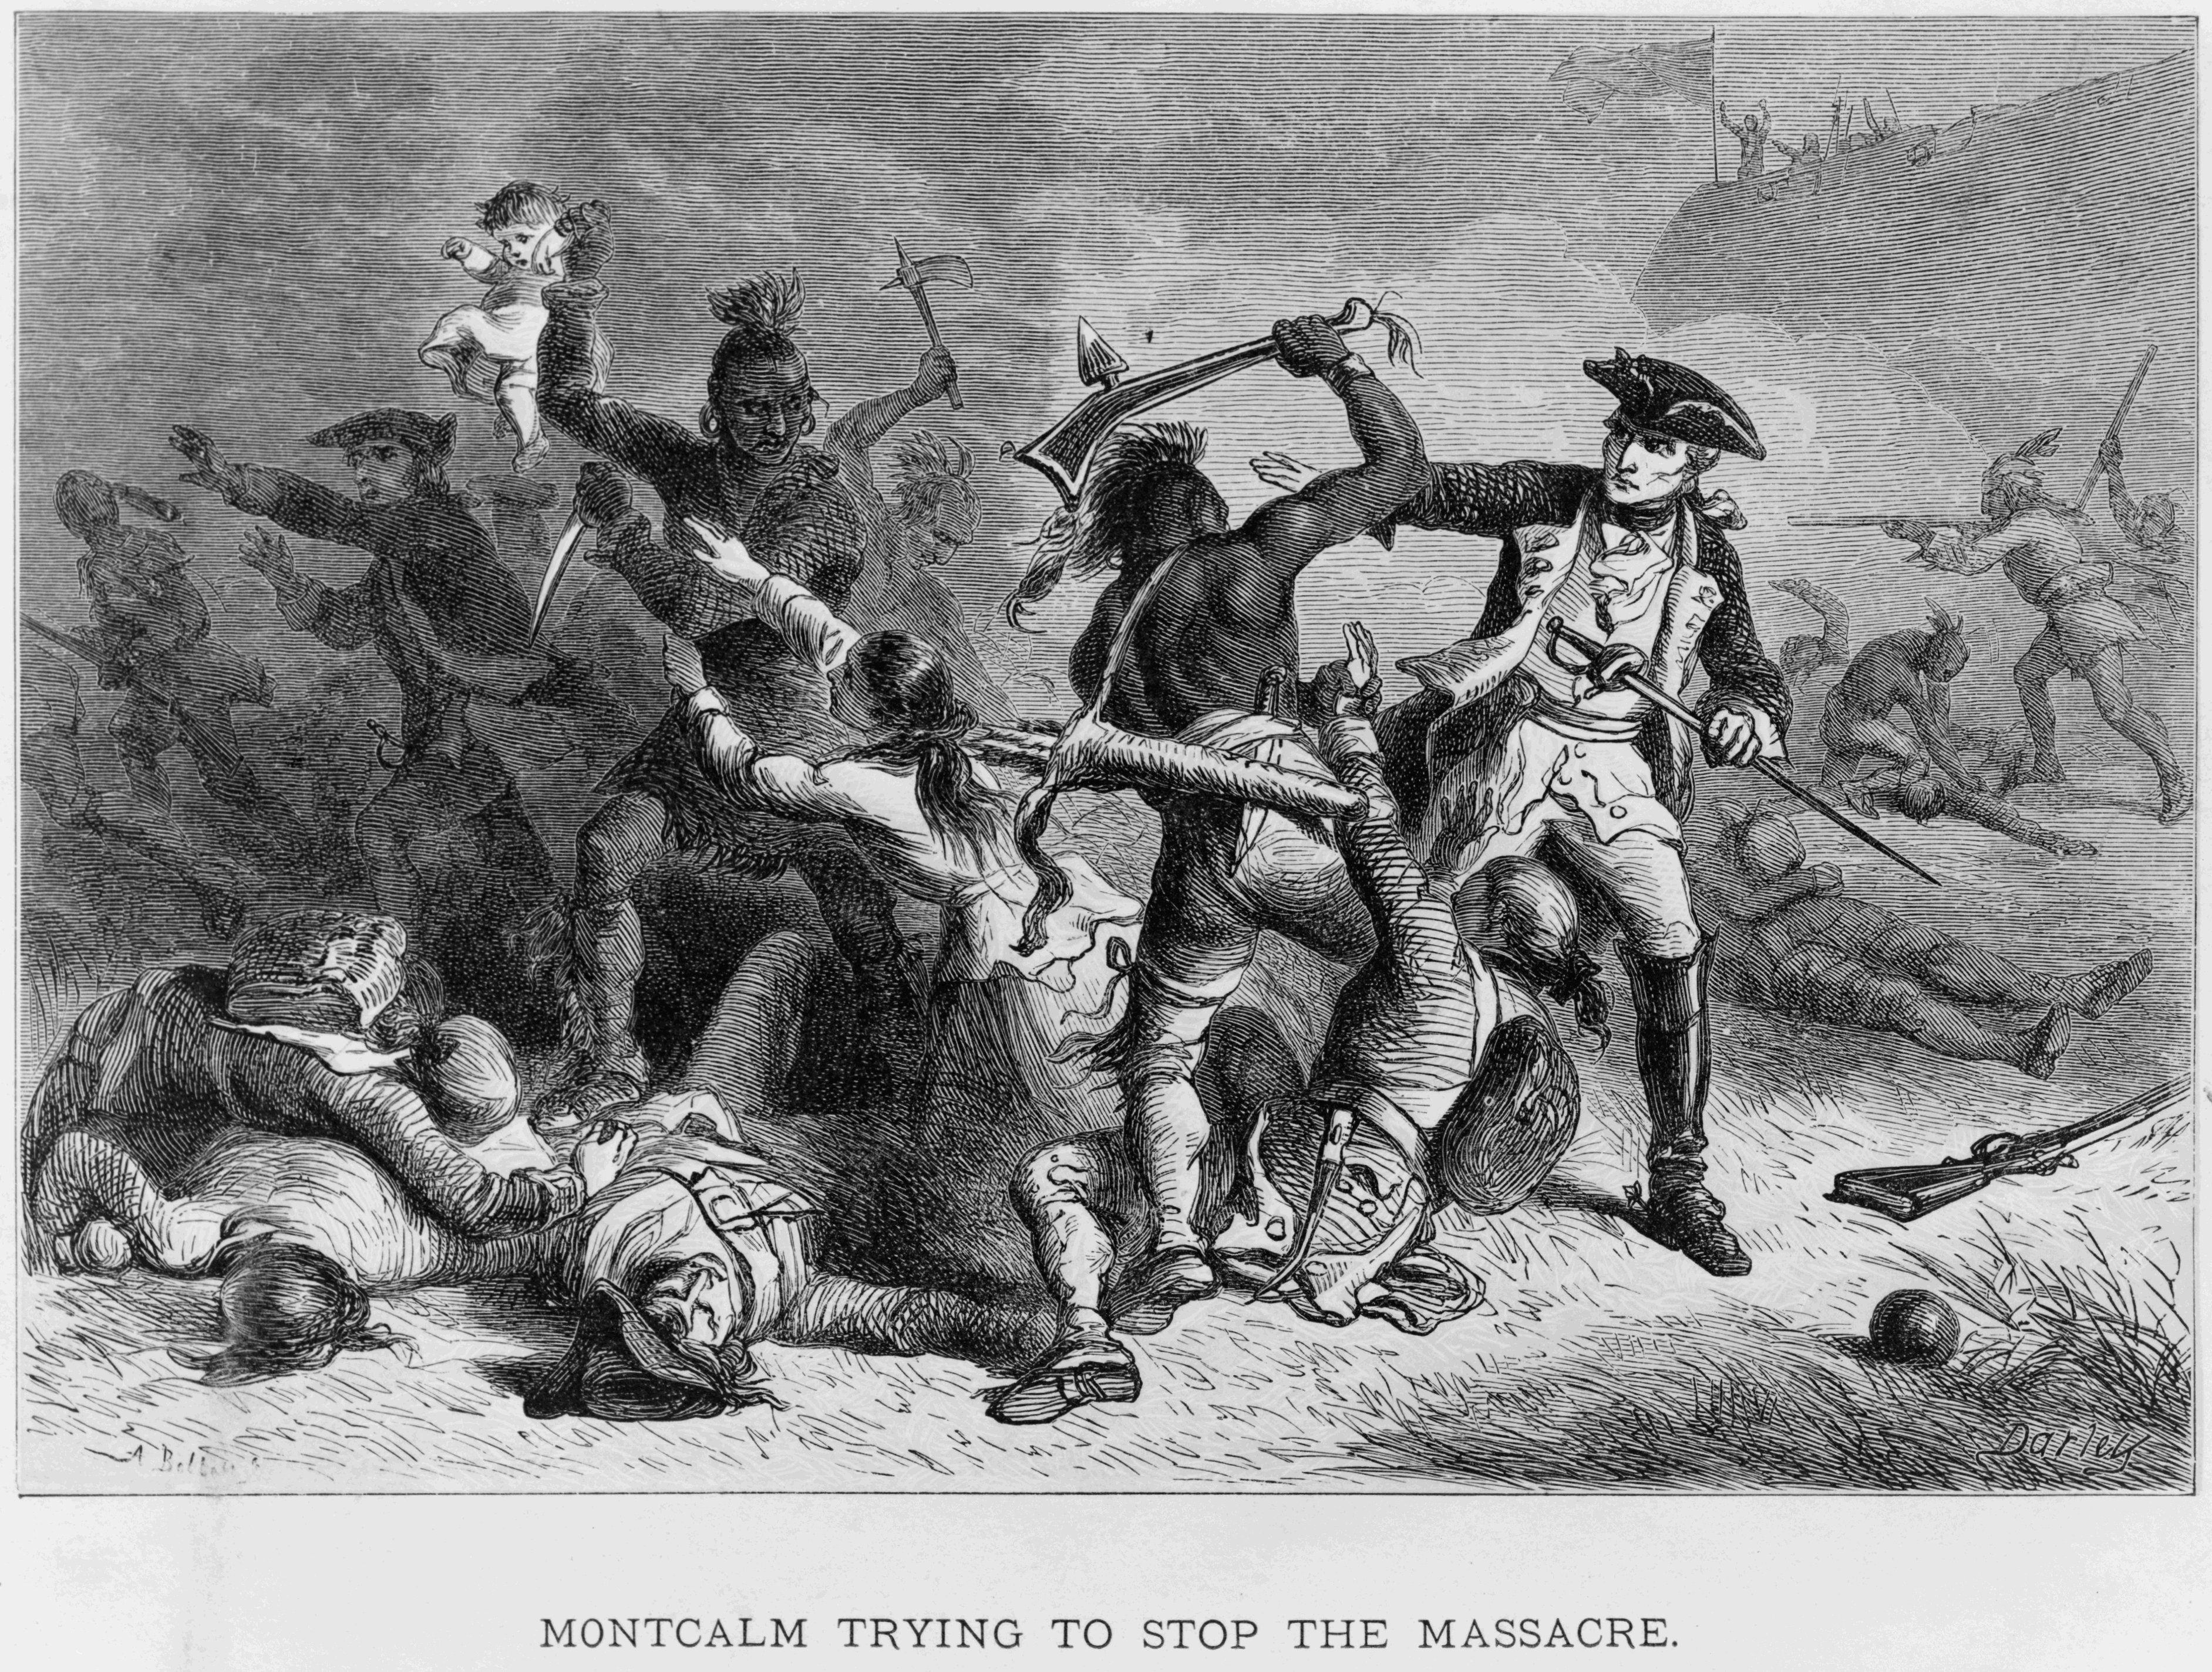
Fort William Henry August 1757
Phase 2
The British surrendered after enduring five days of heavy bombardment from an army of French soldiers and Indian warriors.
The French allowed the British to leave peacefully.
However, their Indian allies brutally attacked the fleeing British soldiers and civilians.
They took several hostages and killed roughly forty others.
Some French officers did attempt to stop the slaughter, but others did nothing to protect the British.

Slide 37
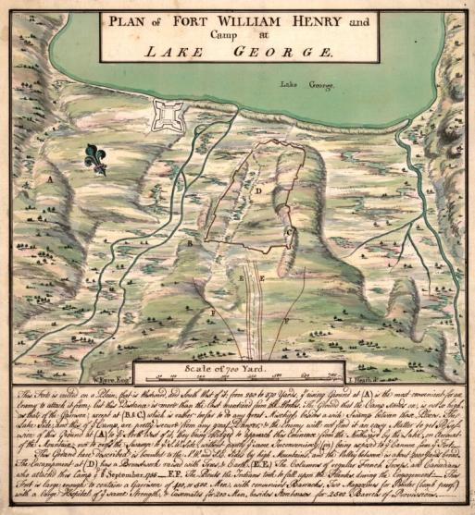
Fort William Henry August 1757
Phase 2
The Battle of Fort William Henry is perhaps one of the most famous battles of the war.
James Fenimore Cooper’s novel, The Last of the Mohicans, immortalized the aftermath of the siege.
Ironically, the battle had no real strategic significance.

Slide 38
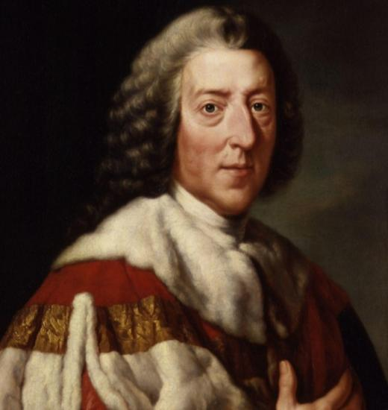
William Pitt
Phase 3
By 1758, British Secretary of State William Pitt was given almost complete control over the war effort.
Pitt viewed North America as the most important theater of the war.
In order to devote more British troops and ships to North America, Pitt paid the Prussian monarch for supplies and soldiers to fight the war in Europe.
To gain support in the colonies, Pitt reimbursed colonial governments that provided militia and supplies.

Slide 39
The St. Lawrence River
Phase 3
The French and Indian War may have started as a dispute over conflicting land claims in the Ohio River valley.
However, William Pitt had redefined it as a struggle between Britain and France for control of eastern North America.
The French controlled Eastern Canada, which consisted of a string of settlements along the St. Lawrence River from the Atlantic to the Great Lakes.
With their capital at Montreal, the most strategic location was the heights occupied by the city of Quebec, which overlooked a crucial bend in the river.
However, the mouth of the Saint Lawrence was well guarded from a French fortress located at Louisbourg on the Ile Royale.

Slide 40
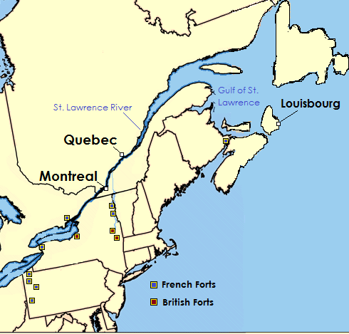
Siege of Louisbourg June 8 – July 26, 1758
Phase 3
Beginning in early June, General Jeffrey Amherst led an attack against the French fortress at Louisbourg.
Amherst was supported by a British naval fleet led by Admiral Edward Boscawen.
An initial landing force led by Brigadier General James Wolfe was able to secure an inlet beach west of the fortress.

Slide 41
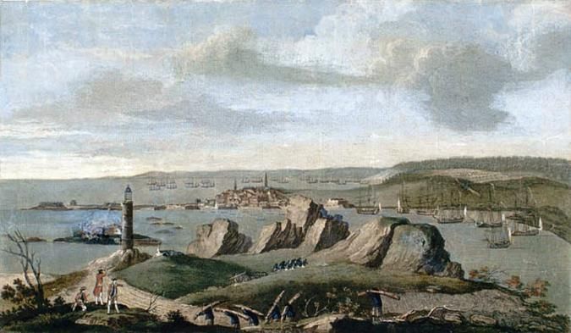
Siege of Louisbourg July 26, 1758
Phase 3
A few days later, Wolfe secured Lighthouse Point located on the opposite side of the harbor.
With the French surrounded, the British began a barrage of canon and mortar fire that lasted more than a month.
On July 25, the last two French ships defending the harbor were captured; French Commander Drucour had little choice but to surrender, which he did on July 26.
The loss of Louisbourg had opened the Saint Lawrence River to the British Navy.
Notes:
Image: View of Louisbourg when that city was besieged in 1758

Slide 42
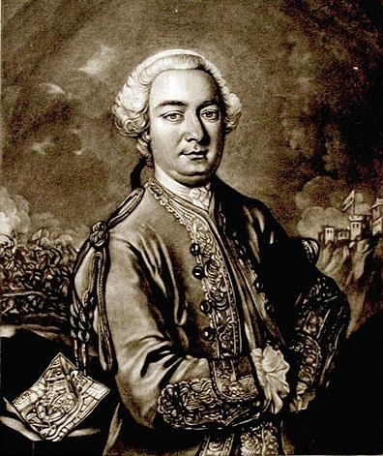
Quebec City
Phase 3
Whoever controlled Quebec could monitor, prevent or permit any traffic that came up or down the river.
With Quebec in British hands:
the French fur trade in the west would be under their control;
the capital of Montreal would be cut off from contact with France.
The city, however, was well-fortified by its natural geography and its man-made defenses.
The British chose General James Wolfe, hero of Louisbourg, to lead the attack against Quebec.

Slide 43
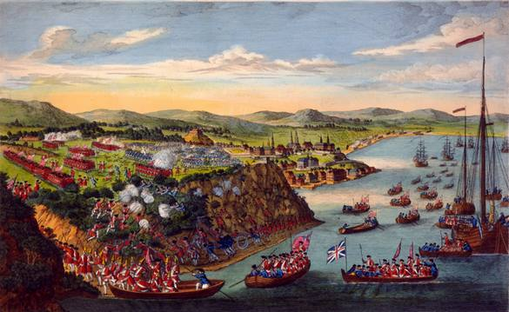
An Impenetrable City
Phase 3
Quebec CIty is located on high ground that rises quickly going in from the banks of the river.
At the top of the hill was The Citadel, a fortress of stone walls with its own internal water supply and ample artillery.
The only reasonably level land adjoining The Citadel was the Plains of Abraham.
However, to reach that area from the river, it was necessary to scale high cliffs.
The climb could be done out of the reach of the French cannons.

Slide 44
It’s Now or Never
Phase 3
Wolfe could not afford to wait too long to attempt a siege of the city and try to get General Montcalm to surrender.
If the fall came without a surrender, the British would have had to end their siege because ice soon would have choked the St. Lawrence River and ended their ability to get supplies.
So, on the night of September 12, 1759, British troops scaled the cliffs rising from the River.
By daybreak, they were gathered on the Plains of Abraham.

Slide 45
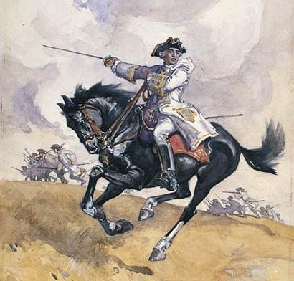
The Battle of Quebec September 13, 1759
Phase 3
General Wolfe challenged General Montcalm to bring his army out of Quebec City and engage the British in open battle.
Remarkably, Montcalm accepted the challenge*.
The British defeated the French.
Both Wolfe and Montcalm were killed in this battle
Montcalm leading his troops at the Plains of Abraham by Charles William Jeffreys
Notes:
*In doing so, Montcalm gave up the great advantage of their defensive, nearly impregnable fortifications. If the French had remained behind the walls of the city, the British would have had to withdraw eventually, and certainly would not have been able to storm the Citadel successfully. To the modern student, the question is always, “Why did Montcalm do that?” and the reasons are still debated today. Was it ego, honor, or foolishness (or a little bit of all three) that led the French general to snatch defeat from the jaws of victory that day?

Slide 46
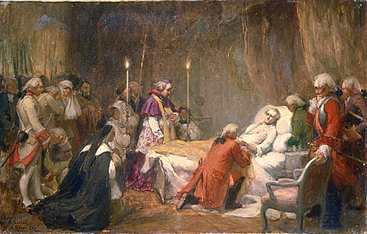
A Double Loss
Phase 3
The British victory on the Plains of Abraham ended French dominance in North America, even though Montreal would not fall for another year.
The war took a few more years to actually end because the European theater had to play out.
Nevertheless, the Battle of Quebec had decided the fate of the North American continent for centuries to follow.
Notes:
Image: The Death of Montcalm by Marc-Aurèle de Foy Suzor-Coté.

Slide 47
The Immediate Outcome

Slide 48
The Treaty of Paris, 1763
The French agreed to give all of its North American holdings east of the Mississippi River to Britain; French territory west of the Mississippi, as well as Cuba, went to Spain.
Spain ceded Florida to Britain, while Britain returned Caribbean sugar islands, as well as trading ports in India, to France.
Britain also promised to allow free practice of the Catholic faith in Canada.
The great European powers agreed to end hostilities and return to status quo antebellum, which means everything went back to the way it was before the war.

Slide 49
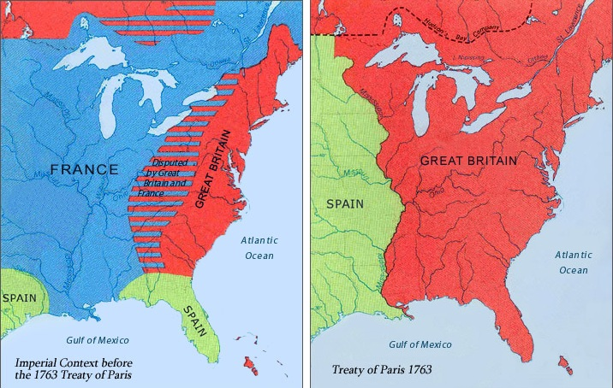
Before
After

Slide 50
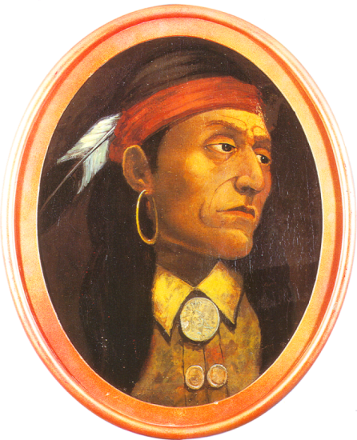
The Proclamation of 1763
After natives who had allied with the French found out they would lose their territory, they began attacking the British and their American colonists.
Many tribes feared that the Iroquois would begin to move into the Ohio Valley and expand their territory.
The Indian uprising was known as Pontiac’s Rebellion and would lead the British, to announce the Proclamation of 1763.
.

Slide 51
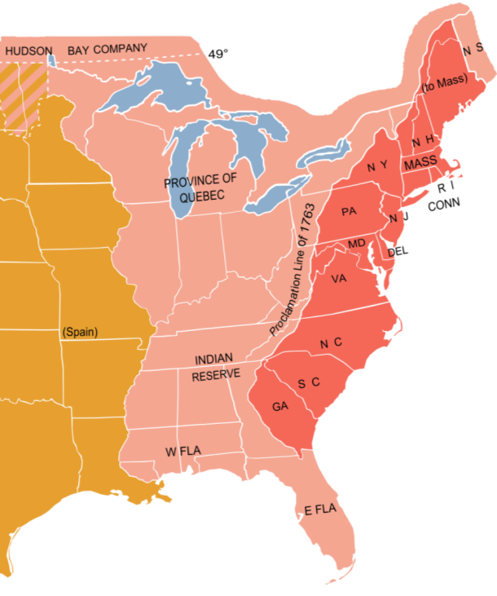
The Proclamation of 1763
The Proclamation of 1763 forbid colonists from settling west of the Appalachian Mountains.
This particularly infuriated the Ulster-Irish frontiersmen who had allied with the British so they could move into the fertile Ohio Valley.
These settlers later became a major component* of the Continental Army during the American Revolution.
Notes:
*40% of Washington’s Army

Slide 52
Consequences
Wars are costly, but this war was particularly expensive; it nearly bankrupted the British treasury.
While the war was fought in Europe and India as well as in North America, many in the British leadership believed, with some justification, that the war had been started by the colonists and was fought to protect them.
In comparison with Britain, the colonies had grown wealthy.
The time had come, the mother country reasoned, for her children in the colonies to pay their fair share, at least in the area of their own protection.
In addition, the rulers of Britain wanted to be sure the colonists did not trigger another costly war.

Slide 53
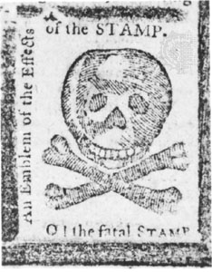
Consequences
With these notions in mind, Britain passed several acts designed to maintain the peace and replenish the British treasury.
The colonists, accustomed to decades of salutary neglect, viewed these acts as intrusive and tyrannical.
They felt they were being unduly punished even though they had contributed much to the recent victory.
Acts such as the Stamp Act, among others, while defensible in Britain were reprehensible to the colonists who greeted each successive act with increased resistance and eventually armed revolt.

Slide 54
Why It matters now

Slide 55
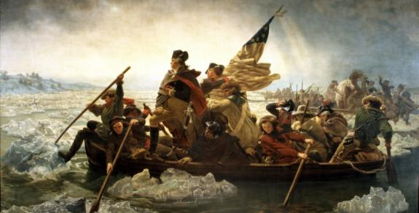
Why It Matters Now
American history and culture might have been quite different had this conflict not occurred and played out as it did:
It set the tone for relations between the European-Americans and American Indians for generations to come.
It determined that the portion of North America that would become the United States and Canada would be dominated by English culture and common law*.
The enormous costs of this war sparked the unrest that led directly to the American Revolution.
Finally, participation in the war gave American colonists the military experience and confidence they would need to win their independence from Britain.
Notes:
*as opposed to French culture and the Justinian legal code of the late Roman Empire

Slide 56
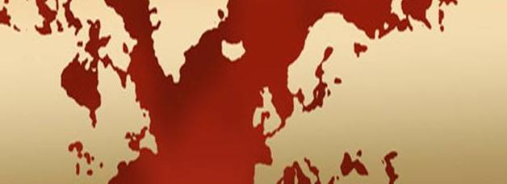
An Anglo Saxon World
On a global scale, the war established a balance of power in the Western world that would remain largely unchanged until the start of the “so-called” First World War in 1914*.
It not only determined which nations would dominate Europe during the later 19th century; it determined which Empire would dominate the world for the following 150 years.
It also set the stage for the Anglo-American cultural and economic domination of the following two centuries.

Slide 57
Bibliography
Fred Anderson. Crucible of War: The Seven Years' War and the Fate of Empire in British North America, 1754-1766 (January 23, 2001).
D.A. Baugh The Global Seven Years War 1754-1763: Britain and France in a Great Power Contest (July 23, 2011).
George Alfred Henty. With Frederick the Great - A Story of the Seven Years' War (Jul y 12, 2010) .
James G. Leynurn. The Scotch Irish: A Social History. (August 30, 1989).
Franz A.J. Szabo. The Seven Years War in Europe: 1756-1763 (September 2, 2007).
Richard W. Van Alstyne. Empire and Independence: The International History of the American Revolution (April 1967).
Russell Weigley. The American Way of War: A History of United States Military Strategy and Policy (June 1, 1977).
END

