Slide 1
U.S. History I
Lesson - Westward Expansion
1800-1860
Notes:
New Jersey Social Studies Standards:
6.1.12.A.3.b: Assess the influence of Manifest Destiny on foreign policy during different time periods in American history.
6.1.12.A.3.c: Determine the extent to which America’s foreign policy (i.e., Tripoli pirates, the Louisiana Purchase, the War of 1812, the Monroe Doctrine, the War with Mexico, and Native American removal) was influenced by perceived national interest.
6.1.12.A.3.h: Determine the extent to which state and local issues, the press, the rise of interest-group politics, and the rise of party politics impacted the development of democratic institutions and practices.
6.1.12.A.3.i: Examine multiple perspectives on slavery and evaluate the claims used to justify the arguments.
6.1.12.B.3.a: Examine the origins of the antislavery movement and the impact of particular events, such as the Amistad decision, on the movement.
6.1.12.C.3.a: Assess the impact of Western settlement on the expansion of United States political boundaries.
6.1.12.D.3.b: Determine how expansion created opportunities for some and hardships for others by considering multiple perspectives.
6.1.12.D.3.c: Explain how immigration intensified ethnic and cultural conflicts and complicated the forging of a national identity.
6.1.12.D.3.d: Assess how states' rights (i.e., Nullification) and sectional interests influenced party politics and shaped national policies (i.e., the Missouri Compromise and the Compromise of 1850).

Slide 2
Learning Objectives
By the end of this section, you will be able to:
Explain the significance of the Louisiana Purchase
Analyze why the North and South differed over the admission of Missouri as a state
Explore why American settlers in Texas sought independence from Mexico
Identify the causes of the Mexican-American War
Describe the outcomes of the war in 1848, especially the Mexican Cession
Explain why sectional and political divisions in the United States grew
Describe the terms of the Compromise of 1850
Describe the effect of the California Gold Rush on westward expansion
© Jul 21, 2017 OpenStax

Slide 3
Word Wall
Manifest Destiny Popular Sovereignty
Corps of Discovery Northwest Passage
Adams-Onís Treaty The Louisiana Purchase
Mexican-American War The Missouri Compromise
Tejanos Texas Annexation
Compromise of 1850 Abolitionists
© Jul 21, 2017 OpenStax

Slide 4
Reflection #1
Before you begin this lesson take a moment to reflect on some of your prior knowledge of the westward expansion of the United States.
Do you believe the westward expansion of the United States was unavoidable? Why or why not?
© Jul 21, 2017 OpenStax

Slide 5
Introduction
In the first half of the nineteenth century, settlers began to move west of the Mississippi River in large numbers. In John Gast’s American Progress (ca. 1872), the figure of Columbia, representing the United States and the spirit of democracy, makes her way westward, literally bringing light to the darkness as she advances.
In the first half of the nineteenth century, the quest for control of the West led to the Louisiana Purchase, the annexation of Texas, and the Mexican-American War. The belief that the expansion of the US throughout the American continents was both justified and inevitable (Manifest Destiny). Efforts to seize western territories from native peoples and expand the republic by warring with Mexico succeeded beyond expectations. This expansion led to debates about the fate of slavery in the West, creating tensions between North and South that ultimately led to the collapse of American democracy and a brutal civil war.
© Jul 21, 2017 OpenStax

Slide 6
Northwest Passage
For centuries Europeans had mistakenly believed an all-water route across the North American continent existed. This “Northwest Passage” would afford the country that controlled it not only access to the interior of North America but also a relatively quick route to the Pacific Ocean and to trade with Asia. The Spanish, French, and British searched for years before American explorers took up the challenge of finding it.
© Jul 21, 2017 OpenStax

Slide 7
JEFFERSON’S CORPS OF DISCOVERY HEADS WEST
Many Americans also dreamed of finding a Northwest Passage and opening the Pacific to American commerce and influence, including President Thomas Jefferson. Corps of Discovery was the group led by Meriwether Lewis and William Clark on the expedition to explore and map the territory acquired in the Louisiana Purchase. In April 1803, Jefferson achieved his goal of purchasing the Louisiana Territory from France for $15 million, effectively doubling the size of the United States.
President Jefferson quickly set out to learn precisely what he had bought and to assess its potential for commercial exploitation. Above all else, Jefferson wanted to exert U.S. control over the territory, an area already well known to French and British explorers. It was therefore vital for the United States to explore and map the land to pave the way for future white settlement.
© Jul 21, 2017 OpenStax

Slide 8
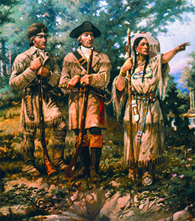
JEFFERSON’S CORPS OF DISCOVERY HEADS WEST
In this idealized image, Sacagawea leads Lewis and Clark through the Montana wilderness. In reality, she was still a teenager at the time and served as interpreter; she did not actually guide the party, although legend says she did. Kidnapped as a child, she would not likely have retained detailed memories about the place where she grew up.
Jefferson wanted to legitimize American claims to the land against rivals, such as Great Britain and Spain. Lewis and Clark were thus instructed to map the territory through which they would pass and to explore all tributaries of the Missouri River. This part of the expedition struck fear into Spanish officials, who believed that Lewis and Clark would encroach on New Mexico, the northern part of New Spain. Spain dispatched four unsuccessful expeditions from Santa Fe to intercept the explorers. Lewis and Clark also had directives to establish friendly relationships with the western tribes, introducing them to American trade goods and encouraging warring groups to make peace.
© Jul 21, 2017 OpenStax

Slide 9
CORPS OF DISCOVERY AND THE ADAMS-ONÍS TREATY
In 1803, Thomas Jefferson appointed Meriwether Lewis to organize an expedition into the Louisiana Territory to explore and map the area but also to find an all-water route from the Missouri River to the Pacific Coast. The Louisiana Purchase and the journey of Lewis and Clark’s Corps of Discovery captured the imagination of many, who dedicated themselves to the economic exploitation of the western lands and the expansion of American influence and power.
In the South, the Adams-Onís treaty legally secured Florida for the United States, though it did nothing to end the resistance of the Seminoles against American expansionists. At the same time, the treaty frustrated those Americans who considered Texas a part of the Louisiana Purchase. Taking matters into their own hands, some American settlers tried to take Texas by force.
© Jul 21, 2017 OpenStax

Slide 10
THE MISSOURI COMPROMISE
Another stage of U.S. expansion took place when inhabitants of Missouri began petitioning for statehood beginning in 1817. The Missouri territory had been part of the Louisiana Purchase and was the first part of that vast acquisition to apply for statehood. When the status of the Missouri territory was taken up in earnest in the U.S. House of Representatives in early 1819, its admission to the Union proved to be no easy matter, since it brought to the surface a violent debate over whether slavery would be allowed in the new state.
Congress finally came to an agreement, called The Missouri Compromise, in 1820. Missouri and Maine (which had been part of Massachusetts) would enter the Union at the same time, Maine as a free state, Missouri as a slave state.
© Jul 21, 2017 OpenStax

Slide 11
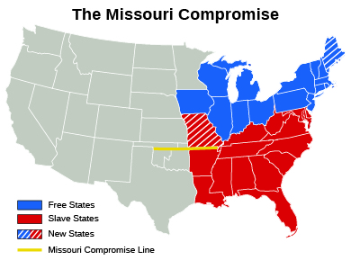
THE MISSOURI COMPROMISE
The Missouri Compromise resulted in the District of Maine, which had originally been settled in 1607 by the Plymouth Company and was a part of Massachusetts, being admitted to the Union as a free state and Missouri being admitted as a slave state.
© Jul 21, 2017 OpenStax

Slide 12
Reflection #2
For what purposes did Thomas Jefferson send Lewis and Clark to explore the Louisiana Territory? What did he want them to accomplish?
© Jul 21, 2017 OpenStax

Slide 13
AMERICAN SETTLERS MOVE TO TEXAS
After the 1819 Adams-Onís Treaty defined the U.S.-Mexico boundary, the Spanish Mexican government began actively encouraging Americans to settle their northern province. Texas was sparsely settled, and the few Mexican farmers and ranchers who lived there were under constant threat of attack by hostile Indian tribes, especially the Comanche, who supplemented their hunting with raids in pursuit of horses and cattle.
The soil and climate offered good opportunities to expand slavery and the cotton kingdom. Land was plentiful and offered at generous terms. Unlike the U.S. government, Mexico allowed buyers to pay for their land in installments and did not require a minimum purchase. Furthermore, to many whites, it seemed not only their God-given right but also their patriotic duty to populate the lands beyond the Mississippi River, bringing with them American slavery, culture, laws, and political traditions
© Jul 21, 2017 OpenStax

Slide 14
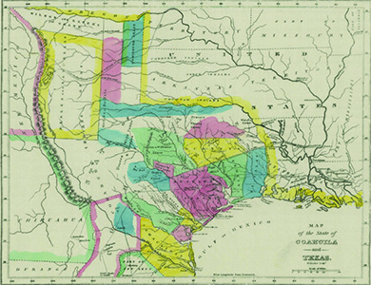
THE TEXAS WAR FOR INDEPENDENCE
This 1833 map shows the extent of land grants made by Mexico to American settlers in Texas. Nearly all are in the eastern portion of the state, one factor that led to war with Mexico in 1846.
Texans’ hopes for independence were defeated several times during the early1800’s. Finally in 1836, Texans declared their independence from Mexico and drafted a constitution calling for an American-style judicial system and an elected president and legislature. Significantly, they also established that slavery would not be prohibited in Texas. Many wealthy Tejanos supported the push for independence, hoping for liberal governmental reforms and economic benefits. Tejanos were the Mexican residents of Texas.
© Jul 21, 2017 OpenStax

Slide 15
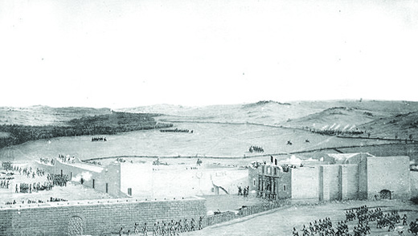
REMEMBER THE ALAMO!
The Fall of the Alamo, painted by Theodore Gentilz fewer than ten years after this pivotal moment in the Texas Revolution, depicts the 1836 assault on the Alamo complex.
The Texas forces under Sam Houston came upon Santa Anna’s encampment on the banks of San Jacinto River on April 21, 1836. The seven hundred men descended on a sleeping force nearly twice their number with cries of “Remember the Alamo!” Within fifteen minutes the Battle of San Jacinto was over. Approximately half the Mexican troops were killed, and the survivors, including Santa Anna, taken prisoner.
© Jul 21, 2017 OpenStax

Slide 16
The Mexican American War and Texas Annexation
The Texas annexation was the 1845 incorporation of the Republic of Texas into the United States of America, which was admitted to the Union as the 28th state on December 29, 1845. The Republic of Texas declared independence from the Republic of Mexico on March 2, 1836.
By 1848, the United States had won the Mexican-American War. Winning the war was encouraging to many Americans for a variety of reasons. The victory fostered the belief that the country was accomplishing its manifest destiny of expansion.
© Jul 21, 2017 OpenStax

Slide 17
Free Soil or Slave? The Dilemma of the West
The 1848 treaty with Mexico did not bring the United States domestic peace. Instead, the acquisition of new territory revived and intensified the debate over the future of slavery in the western territories, widening the growing division between North and South and leading to the creation of new single-issue parties. Increasingly, the South came to regard itself as under attack by radical northern abolitionists. These abolitionists spoke out about slavery in great strength and number.
Most northerners, except members of the Free-Soil Party, favored popular sovereignty for California and the New Mexico territory. Many people agreed that the people of these individual territories should decide the issue of slavery through their elected representatives. Many southerners opposed this position, however, for they feared residents of these regions might choose to outlaw slavery.
© Jul 21, 2017 OpenStax

Slide 18
The Compromiser of 1850
Beginning in January 1850, Congress worked for eight months on a compromise that might quiet the growing sectional conflict. Led by the aged Henry Clay, members finally agreed to the following:
1. California, which was ready to enter the Union, was admitted as a free state in accordance with its state constitution.
2. Popular sovereignty was to determine the status of slavery in New Mexico and Utah, even though Utah and part of New Mexico were north of the Missouri Compromise line.
3. The slave trade was banned in the nation’s capital. Slavery, however, was allowed to remain.
4. Under a new fugitive slave law, those who helped runaway slaves or refused to assist in their return would be fined and possibly imprisoned.
The Compromise of 1850 brought temporary relief. It resolved the issue of slavery in the territories for the moment and prevented secession. The peace would not last, however. Instead of relieving tensions between North and South, it had actually made them worse.
© Jul 21, 2017 OpenStax

Slide 19
Reflection #3
Consider the arguments over the expansion of slavery made by both northerners and southerners in the aftermath of the U.S. victory over Mexico. Who had the more compelling case? Or did each side make equally significant arguments?
© Jul 21, 2017 OpenStax

