Slide 1
British Settlements in North America

Slide 2
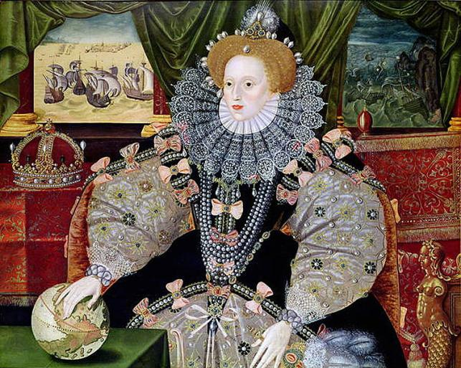
The English in North America
In 1497, John Cabot led the first expedition to the New World financed by England.
His objective was to find the Northwest Passage.
At the time, England was not interested in establishing settlements.
Conflict with Spain, however, would soon reshape England’s policies.
In 1584, Queen Elizabeth I granted a charter to Sir Walter Raleigh to establish the first English settlement.
The Queen had hoped that New World settlements would generate wealth and provide a base from which English privateers could attack Spanish treasure ships.
Notes:
This portrait of the queen was painted to commemorate the 1588 defeat of the Spanish Armada.

Slide 3
Charters
Background Information
These documents, signed by the king or queen, gave a person or group permission to establish a company, a university, or a settlement.
A charter could be revoked if the person or group failed to meet any obligations written into the charter.
For example, Sir Walter Raleigh had six years to establish a settlement or he would lose the charter.
Colonial Charters dictated who would hold political power over the colony.
There were three types of Colonial Charters:
Corporate Charters
Proprietary Charters
Royal Charters
Notes:
For more information about colonial charters, watch Dr. Steve Newton’s lecture, “Colonial Charters,” available from the Video section.

Slide 4
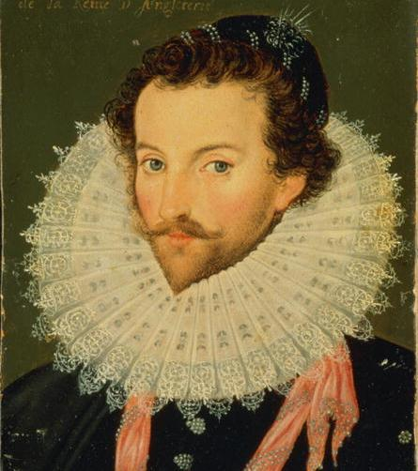
Roanoke
In 1584, Raleigh sent an expedition to scout a suitable site for settlement.
He chose Roanoke, an island off the coast of present-day North Carolina.
In 1585, a group of about 100 men set sail from England to establish the settlement.
However, a lack of supplies and conflict with Indians forced the settlers to return to England about a year later.
Sir Walter Raleigh never visited North America himself.

Slide 5
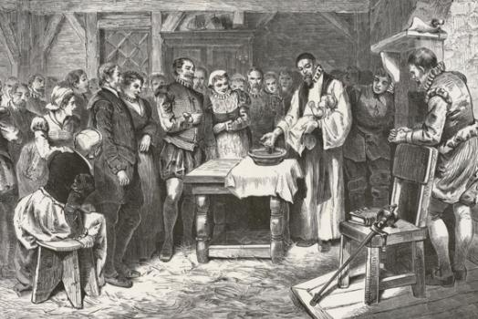
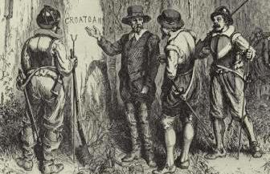
The Lost Colony
In 1587, another group of colonists landed at Roanoke.
Later that year, Roanoke’s governor, John White, returned to England for supplies.
The relief ships were held up when the Spanish Armada launched a full scale attack against the English.
When White was finally able to return, the settlement was deserted – what happened to the settlers is still a mystery.
Notes:
Top Image: The Baptism of Virginia Dare. Born on August 18, 1587, Virginia Dare was the first English child born in the New World. Governor John White was her grandfather.
Bottom Image: CROATOAN. According to one report, the Roanoke settlers left behind some clues. The word the name of the local Indians and a nearby island (Croatoan) had been carved into a wooden post and the letters "CRO" were carved into the trunk of a tree. Before leaving the colony, White instructed the settlers to carve a cross on a tree nearby if they were ever forced to flee. However, there was no cross and all of the buildings were disassembled. This led White to believe that their departure was voluntary. He thought that the carving may have indicated that they moved to Croatoan Island. However, a storm was approaching and the crew refused to continue the search. They departed the area the following day.

Slide 6
The First Charter of Virginia
In 1606, King James I granted the First Charter of Virginia.
This corporate charter created the London and Plymouth Companies, joint-stock companies known together as the first Virginia Company*.
The charter granted each division of the Virginia Company permission to establish settlements within specific areas along the Atlantic coast:
London Company settlements could be established between the 34th and 41st Parallels;
Plymouth Company settlements could be established between the 38th and 45th Parallels**
In 1607, the London Company established Jamestown in the Chesapeake Bay area while the Plymouth Company founded the colony of Popham in present-day Maine.
Notes:
*These companies are sometimes referred to as the Virginia Company of London and the Virginia Company of Plymouth.
**Notice that these areas overlap between the 38th and 41st Parallels. The combined area stretched from the northern border of present-day North Carolina to the northern border of present-day Maine.

Slide 7
Corporate Charters
Background Information
The cost of establishing and maintaining a colony was enormous - more than most individuals could bear.
In the late 14th and early 15th centuries, some tried to convince the English monarchy to finance settlement; but at that time, England was not as wealthy as other European nations.
Instead, the monarchy granted corporate charters establishing joint-stock companies that would take full financial responsibility for establishing and maintaining the colony.
The company was given the power to appoint officials.
Profits from the settlement would be divided among the investors, with a specified portion set aside for the monarch.

Slide 8
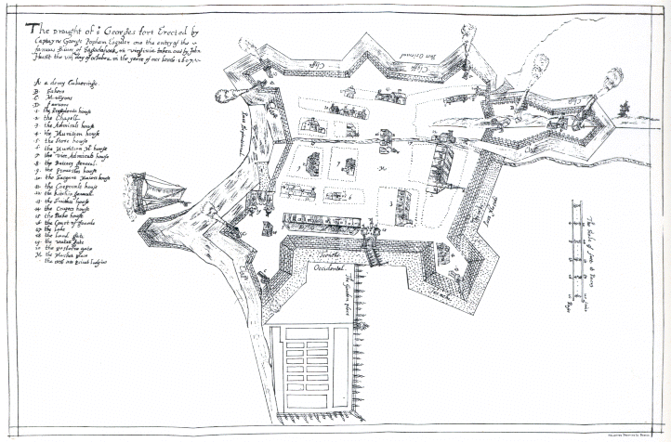
Popham
In 1607, the Plymouth Company established the colony of Popham in present-day Maine.
Barely one year later, Popham was abandoned.
The demise of the colony was blamed on a change in leadership.
The Plymouth Company was also abandoned until 1620, when it was revived as the Plymouth Council for New England.
Notes:
The map shown here was drawn by one of the Popham colonists, John Hunt.

Slide 9
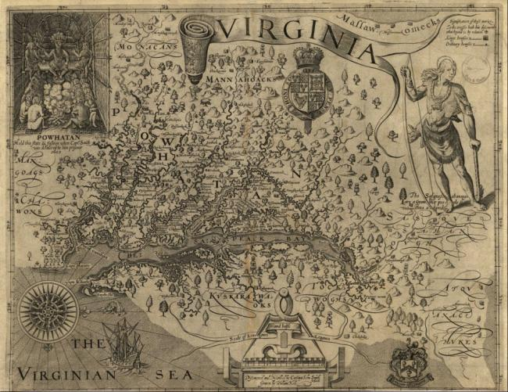
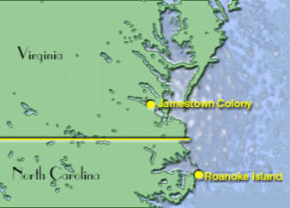
Jamestown (Virginia)
On May 14, 1607, the colony of Jamestown was established.
The first winter was harsh.
By the end of 1607, more than 60 men were dead.
Captain John Smith, leader of the settlement, leapt into action:
He applied strict rules for the settlers;
He also persuaded local Indians to supply meat and fish.
(top) John Smith’s map of Jamestown.
(right) Jamestown in relation to Roanoke.

Slide 10
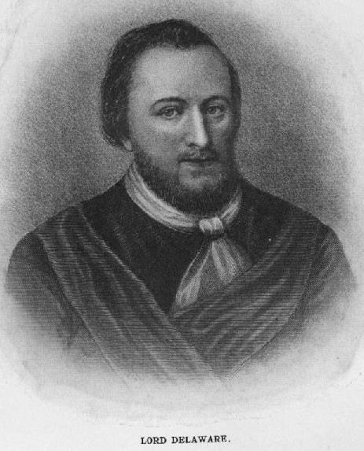
Jamestown (Virginia)
Unfortunately, Smith was injured and had to return to England.
The winter that followed was especially brutal.
The settlers decided it was time to abandon Jamestown.
Suddenly, British ships arrived led by Lord de la Warr.
De la Warr forced the settlers tough it out.

Slide 11
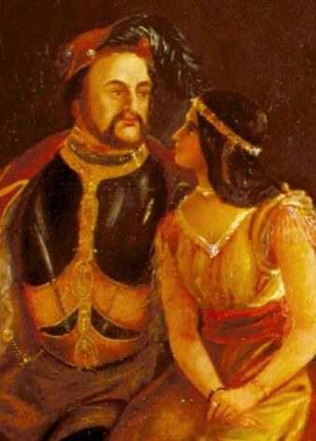
Jamestown (Virginia)
In 1612, a settler named John Rolfe harvested tobacco grown in the rich Virginia soil.
Soon, Virginia tobacco was in high demand.
Tobacco became an important cash crop that made the Virginia Colony extremely prosperous.
Jamestown had survived; it was the first permanent English settlement in the New World.
(Left) John Rolfe with wife Pocahontas.
(Bottom) A Tobacco crop.

Slide 12
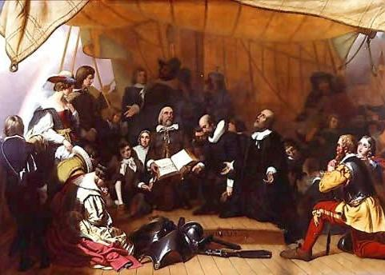
Plymouth
In 1619, English Separatists received a grant from the London Company.
They were to establish a colony near the Hudson River.
To raise money, they formed a joint-stock company with other prospective colonists and a group of London investors.
On September 6, 1620, they set sail from England aboard the Mayflower.
Less than 40 of the 102 passengers aboard the Mayflower were Separatists.
Notes:
This includes Roman Catholics as well as Separatists.

Slide 13
The Puritans
Background Information
Beginning in the 16th Century, the Anglican Church broke away from the Roman Catholic Church, becoming the official church of England*.
A group known as the Puritans soon emerged:
They were Calvinists who believed that the Anglican Church was still too much like the Roman Catholic Church.
By the end of the century, the Puritans split into two factions:
Those who believed that the Anglican Church could be reformed.
Those who rejected the Anglican Church completely and wanted the freedom to form their own churches; this more radical faction were known as Separatists**.
By the 17th century, those who rejected the Church of England had two choices***:
Practice their religion in secrecy
Leave England
Notes:
*The Anglican Church is also referred to as the Church of England.
**They were also known as Congregationalists, Independents, and later, Pilgrims.
***This also applied to Roman Catholics.

Slide 14
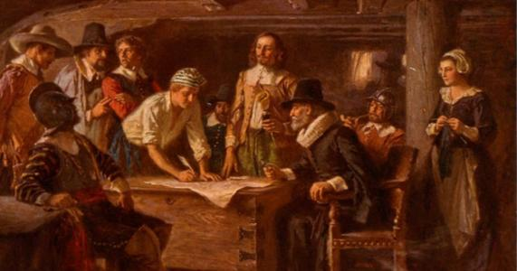
Plymouth
The Mayflower landed nearly 400 miles farther north than intended.
Before leaving the ship on November 11, the colonists established a government by signing the Mayflower Compact.
Signers of the Mayflower Compact agreed to establish “just and equal laws” for “the general good.”
The first winter was harsh; luckily, they met an English-speaking Indian named Squanto:
He taught the colonists what to plant and where to fish.
He also helped negotiate a peace treaty with Massasoit, chief of the Wampanoag Indians.

Slide 15
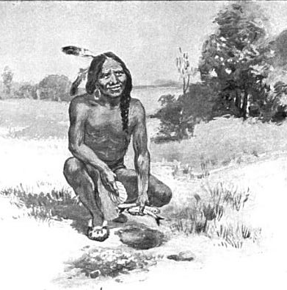
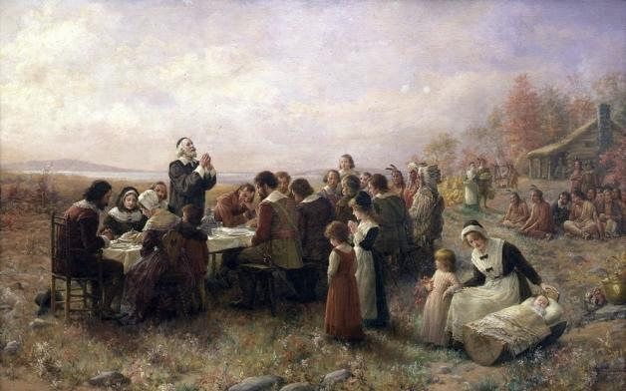
Plymouth
Relations between the settlers and the natives remained peaceful until 1662.
Settlers’ actions eventually provoked a war that ended with a crushing defeat of the Wampanoag and their allies*.
In 1686, Plymouth and 4 other colonies were united under the rule of one royally appointed governor**.
In 1691, new charters were granted; Plymouth became part of Massachusetts Bay.
It is believed that Squanto was one of the guests at the first Thanksgiving, held in Plymouth in 1621.
Notes:
*For more information, read the biography of Metacom, available from CICERO/Unit 3/Heroes.
**See the slide titled “Dominion of New England”

Slide 16
The Council for New England*
Background Information
This joint-stock company was a reincarnation of the Plymouth Company created in 1606 by the First Charter of Virginia.
The new charter, granted in 1620, gave the council the right to establish settlements between the 40th and 48th parallels.
The Plymouth Colony became the council’s first settlement, despite the fact that the Plymouth colonists originally gained their charter from the London Company.
Three years after the Plymouth Colony was established, the council granted sections of its territory to other proprietors and joint stock companies including:
Captain John Mason (New Hampshire)
Sir Ferdinando Gorges (Maine)
Massachusetts Bay Company (Massachusetts)
Notes:
*Also known as the Plymouth Council for New England.

Slide 17
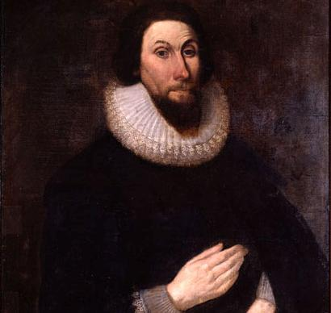
Massachusetts Bay
In 1629, the Massachusetts Bay Company was formed to fund the settlement of a Puritan colony in North America.
The Puritans hoped to create a society that would serve as a model for England and all of Europe – a “City Upon the Hill.”
In the summer of 1630, John Winthrop and about 1,000 fellow Puritans settled in Massachusetts.
John Winthrop served 12 terms as governor of the Massachusetts Bay colony.

Slide 18
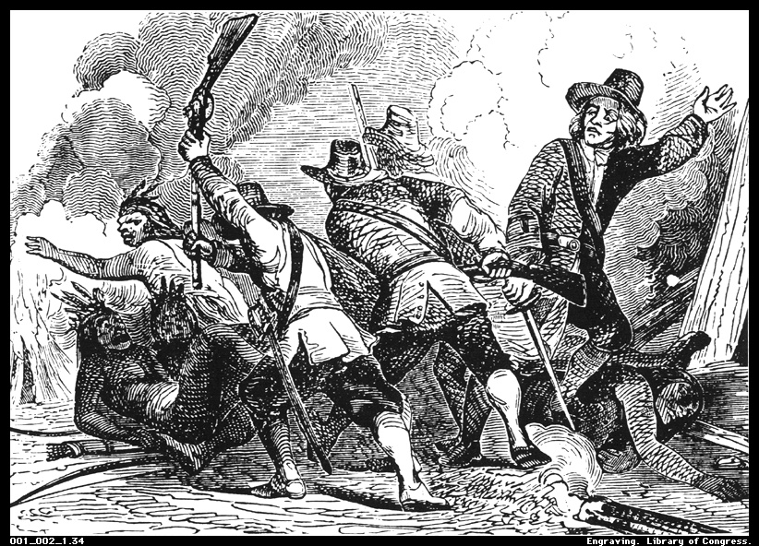
Massachusetts Bay
Unlike earlier colonies, the Puritans brought their charter with them:
A General Court made up of “freemen” was established;
Though still under English rule, the General Court and geographic distance gave them substantial religious and political control.
Massachusetts Bay often used its status as a corporate colony to defy British law.
After the English Civil War*, they were even more defiant.
In 1636, colonists provoked the “Pequot War.” Militia from Massachusetts, Plymouth, and Connecticut, along with native allies, crushed the Pequot nation.
Notes:
*See the slide titled “Turmoil in England”

Slide 19
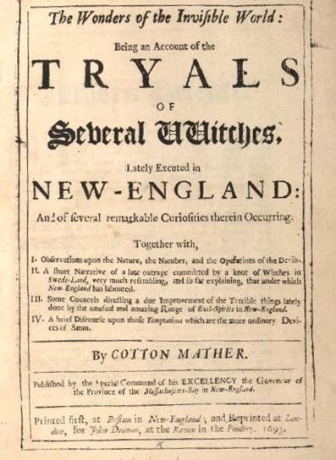
Massachusetts Bay
Once the monarchy was restored* in 1660, their defiance would no longer be tolerated:
In 1684, their charter was revoked.
In 1686, all of New England was placed under the authority of a royally appointed governor**.
The Massachusetts Bay charter was restored in 1691 with some revisions:
The king would still appoint the governor;
the colonial assembly was required to increase non-Puritan representation.
In 1692, a mass panic in Salem Village resulted in the infamous Salem Witch Trials.
Notes:
*See the slide titled “Restoration of the Monarchy”
**See the slide titled “Dominion of New England”

Slide 20
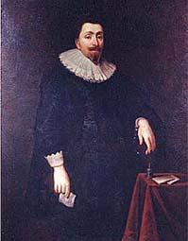
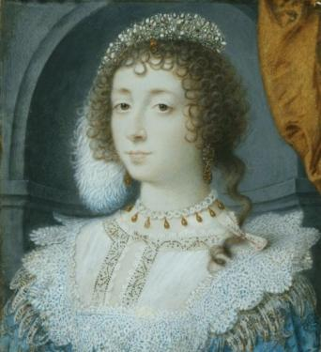
Maryland
Lord Baltimore recognized early on that New World settlement could generate huge profits*.
After becoming Catholic, he realized that the New World may offer more than financial gain:
At the time, anyone who rejected the Church of England faced persecution.
In 1632, Lord Baltimore requested a charter to establish a colony near the Chesapeake Bay.
In addition to turning a profit, he hoped the colony could serve as a safe haven for Christians of all sects.
In 1625, Sir George Calvert was granted the title “Lord Baltimore.”
Maryland was named for Queen Henrietta Maria , the Catholic wife of King Charles I.
Notes:
*1609 – He invested in the Virginia and East India Companies; 1620 – He bought land in Canada and began a settlement called Avalon.

Slide 21
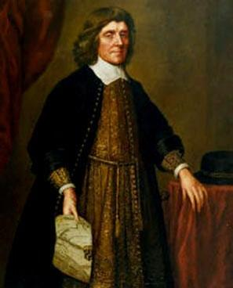
Maryland
A proprietary charter was granted, but before it became official, Lord Baltimore died.
Cecilius Calvert, his eldest son, became the colony’s proprietor.
On March 25*, 1634, the first settlers arrived.
After some early compromises, settlers were granted greater influence over local affairs.
Ambitious tobacco farmers were able to make considerable profits.
In 1649, Cecilius Calvert wrote the Maryland Toleration Act to promote religious tolerance in the colony.
Notes:
*This date is commemorated each year as “Maryland Day.”

Slide 22
Proprietary Charters
Background Information
These charters gave an individual or small group a grant of land and permission to establish a colony within the bounds of the grant.
The proprietor took full financial responsibility for establishing and maintaining the colony.
Proprietors were given tremendous political authority.
When the proprietor dies, the charter is passed to his descendants.
Examples include charters granted to Sir Walter Raleigh (Roanoke), Cecilius Calvert (Maryland), and William Penn (Pennsylvania)
Notes:
For more information about colonial charters, watch Dr. Steve Newton’s lecture, “Colonial Charters,” available from the Video section.

Slide 23
Maryland
Background Information
Maryland, however, was not the Catholic refuge Lord Baltimore had hoped it would be.
Catholics had quickly become a minority and found themselves in danger of persecution yet again.
In 1649, the Assembly passed the Maryland Toleration Act
This act allowed freedom of worship for all Christians* in Maryland.
It was temporarily repealed in 1654, reinstated in 1658, and permanently repealed following the Glorious Revolution.
By 1702, the Church of England was the official church of Maryland.
By 1718, Catholics were not allowed to vote.
Religious tolerance would not return as an ideal in Maryland until the American Revolution.
Notes:
*While this act was remarkably progressive at the time, it should be noted that the law applied to Christians only. American Indians, Jews, and others still faced considerable discrimination.

Slide 24
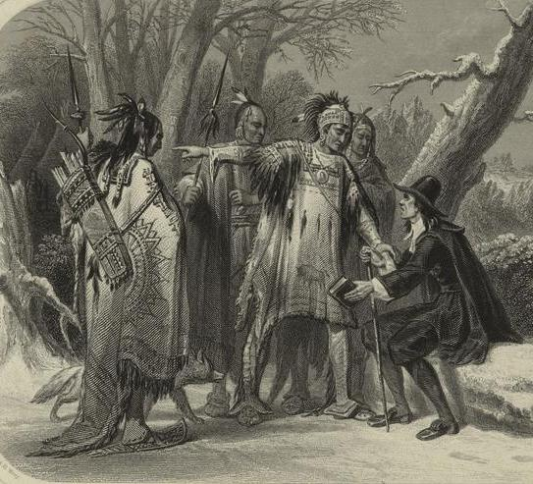
Rhode Island
The radical views of Roger Williams angered Puritan leaders in Massachusetts.
Williams argued for
strict separation of church and state;
complete separation from the Church of England*;
toleration of other religious beliefs
In 1635, he was convicted of sedition and heresy and sentenced to banishment.
He fled to Narragansett Bay, bought land from the Indians**, and established Providence Plantation – the first permanent settlement in what would later become Rhode Island.
Notes:
*Williams believed that the Church of England was too closely tied to the government of England.
**Williams befriended the Narragansett Indians. He studied their language and culture; he even wrote a book on the topic. He argued that colonists had no right to take their land – another view that upset many colonial leaders.

Slide 25
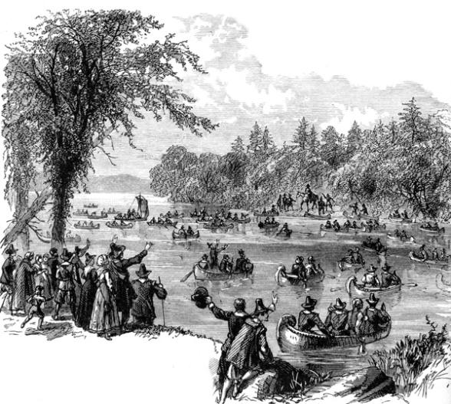
Rhode Island
Providence Plantations attracted other dissenters and victims of religious persecution.
New settlements were soon established.
In 1644, the settlements were granted a corporate charter.
In 1663, Charles II granted the Charter of Rhode Island and Providence Plantations.
Like the 1644 charter, the charter of 1663 guaranteed religious freedom and granted considerable power to the people.
Fellow dissenter Anne Hutchinson and her followers established settlements at Portsmouth and Newport.

Slide 26
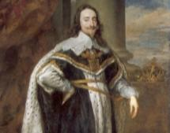
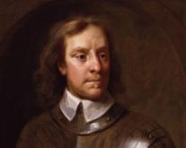
Turmoil in England 1642 - 1659
Background Information
In 1642, a power struggle between the King and Parliament erupted in civil war.
The war ended in 1649 with the execution of King Charles I.
For a brief period, England became a Commonwealth with Oliver Cromwell elected as Lord Protector.
In 1655, however, Cromwell dissolved Parliament and seized power; he ruled England as a military dictatorship until his death in 1658.
During this period of political turmoil, colonization in America was basically put on hold.

Slide 27
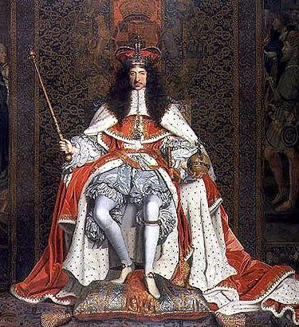
Restoration 1660
Background Information
After Cromwell’s death, there was overwhelming support for a return to monarchy.
Charles II, the eldest son of the executed king, was invited to reclaim the throne.
Under King Charles II, interest in colonization was revitalized.
Additional charters were granted to reward those who had supported the monarchy*.
Some existing charters were rewritten to give England more control over some colonies.
Notes:
*The Carolina Charter is one example of a charter granted to reward individuals who had supported the monarchy.

Slide 28
Royal Charters
Background Information
Royal Charters gave the English monarchy and Parliament more control over colonial affairs.
The monarchy, for example, appointed the governor.
After the restoration of the monarchy, some corporate charters were replaced with royal charters.
For example, the Massachusetts Bay charter was rewritten, in part, to punish colonial leaders who supported Cromwell.

Slide 29
Connecticut
Both the English and the Dutch had claimed land in the Connecticut River Valley.
In the 1630s, English Puritans began asserting their claims in the region:
Date | Settlement | Description
1633 | Windsor | A small group of settlers from Plymouth establish Windsor just north of a Dutch trading post, Fort Hoop.
1634 | Wethersfield | A small group of settlers from Watertown establish Wethersfield just south of Fort Hoop.
1636 | Hartford | 100 settlers led by Thomas Hooker establish Hartford directly across the river from Fort Hoop.
1637 | New Haven | Another group of Puritans led by John Davenport and Theophilus Eaton establish New Haven at the mouth of the Quinnipiac River.
Notes:
Painting: Hooker and Company Journeying through the Wilderness from Plymouth to Hartford, in 1636, by Frederic Edwin Church (1846)

Slide 30
Connecticut
In 1639, Windsor, Wethersfield and Hartford adopted the Fundamental Orders of Connecticut.
The document set up the structure and powers of an independent government;
It also listed individual rights.
In 1662, Connecticut was granted a Royal Charter, which added New Haven to the colony*.
In 1636, colonists provoked the “Pequot War.” Militia from Massachusetts, Plymouth, and Connecticut, along with native allies, crushed the Pequot nation.
Notes:
*This was probably a punishment since the New Haven settlement had harbored three of the judges who had presided over the trial that resulted in the execution of King Charles I.

Slide 31
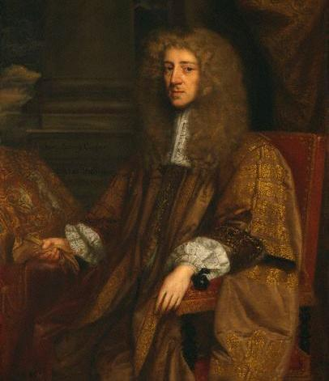
The Carolinas
By 1653, Virginia colonists had already started settling present-day North Carolina.
In 1663, King Charles II granted a charter to 8 “Lords Proprietors” to establish the colony of Carolina.
Originally, the colony stretched from the southern border of Virginia to the northern border of Spanish Florida.
Differences* between northern and southern settlers soon created tension.
Lord Anthony Ashley-Cooper pushed for the development of Carolina.
Notes:
*Most of the north was settled by poor tobacco farmers and frontiersmen. There was also a large population of Quakers; The south was settled by wealthy English plantation owners who deeply resented proprietary rule.

Slide 32
North and South Carolina
In 1691, a deputy governor was appointed to oversee the northern half of Carolina.
By 1712, a completely separate government was established in the north.
In 1729, 7 of the 8 Lords Proprietors sold their share in the colony to the Crown.
North and South Carolina were officially divided into 2 separate royal colonies.

Slide 33
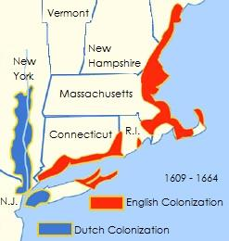
New York
In 1664, King Charles II decided to “reclaim” the territory between New England and Virginia*.
He granted the area, which had been ruled by the Dutch for the last half century, to his brother James, the Duke of York.
In August 1664, Captain Richard Nicholls entered the harbor of New Amsterdam with four ships.
Notes:
*England based the original claim on the explorations of John Cabot in 1497.

Slide 34
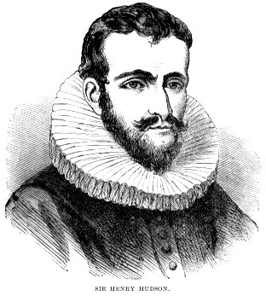
The Dutch in North America
In 1609, the Dutch East India Company hired Henry Hudson to find an all-water route to the Pacific Ocean.
Hudson sailed west, landing at present-day Nova Scotia.
Continuing south, he entered what is now known as the Upper New York Bay and explored the river that now bears his name.
The entire river valley was claimed for the Dutch and named New Netherland.

Slide 35
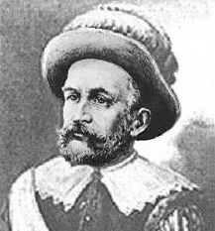
New Amsterdam 1626
In1626, Peter Minuit was appointed governor of New Netherland.
One of Minuit’s first acts was the purchase of Manhattan Island from Indian leaders.
The island was named New Amsterdam and became the capital of the colony.
Minuit lost his post in 1631 and began working for the Swedish government.
Minuit reportedly bought Manhattan Island for 60 guilders worth of goods – the total value of which would be about $1,000 today.

Slide 36
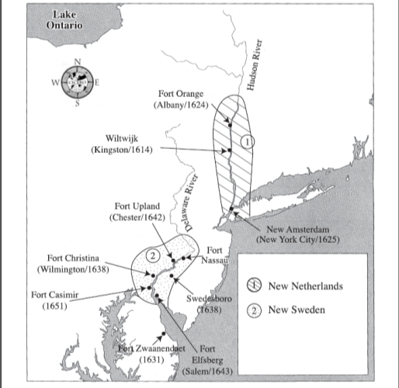
New Sweden
In 1638, Minuit reached the Delaware Bay with Swedish and Finnish colonists.
He purchased land along the Delaware River from local Indians.
By 1643, Swedish settlements were peppered along the river.
In 1655, the Dutch seized the territory and New Sweden became part of New Netherland.
By the 1660s, neighboring English settlers outnumbered New Netherland settlers nearly 6 to 1.

Slide 37
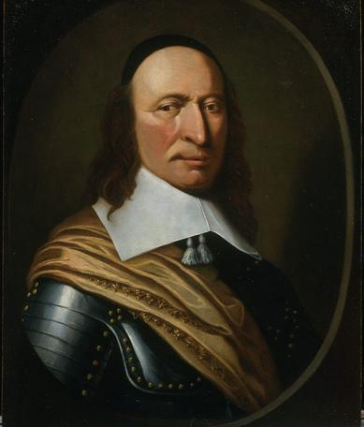
New York
A letter was sent to Peter Stuyvesant, Director General of New Netherland, demanding surrender.
Without a fleet of his own and with no popular support, Stuyvesant was forced to back down.
By September, an agreement was signed and the territory was renamed New York.
Peter Stuyvesant, Director General of New Netherland

Slide 38
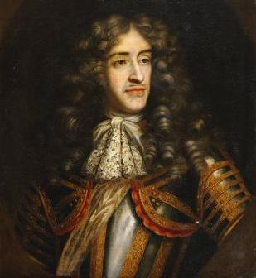
New York
The territory seized by England was enormous:
It included the present-day states of New York, New Jersey, Delaware and Vermont.
It also included eastern Pennsylvania and parts of Connecticut and Maine.
The area was divided into smaller grants and distributed among various proprietors.
Dutch settlers were allowed to stay and were soon joined by English settlers.
The Duke of York succeeded his brother in 1685 and became King James II.

Slide 39
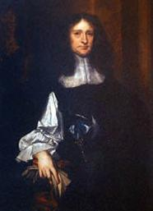
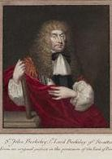
New Jersey
The Duke of York received New Netherland as a grant from King Charles II.
In turn, he granted the area between the Hudson and Delaware rivers to George Carteret and John Berkeley.
The area was renamed for the Island of Jersey.
The two proprietors offered cheap land and religious freedom in an effort to attract settlers.
Carteret (right) and Berkeley (right) were also two of the eight Lords Proprietors of the Province of Carolina.

Slide 40
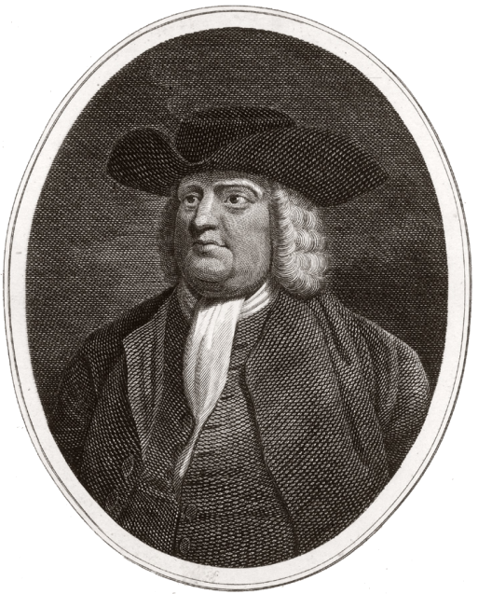
New Jersey
In 1674, Lord Berkeley sold his share of New Jersey to Quakers Edward Byllynge and John Fenwick.
The colony was split into two, separately governed provinces: East Jersey and West Jersey.
When Carteret died in 1680, East Jersey was sold to another group of Quakers that included William Penn.
William Penn

Slide 41
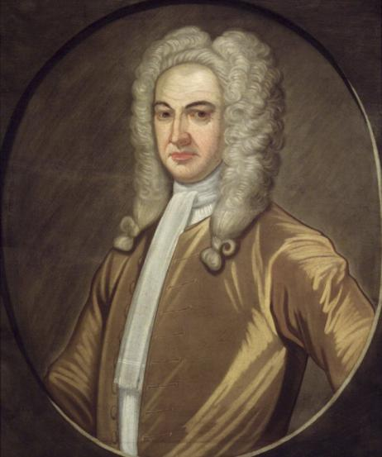
New Jersey
East and West Jersey lost their charters in 1688, but they were restored the following year.
In 1702, East and West Jersey were united.
However, New Jersey shared its governor with New York.
It was not until 1738 that a united New Jersey was appointed its own governor.
Lewis Morris, first governor of a united New Jersey (1738 – 1746)

Slide 42
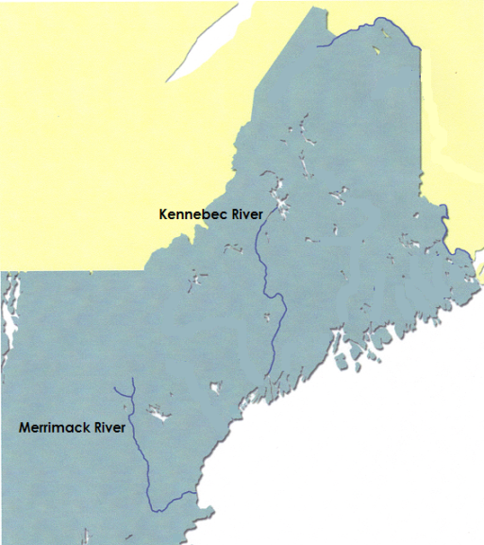
New Hampshire
In 1622, the Council for New England granted a large tract of land to Captain John Mason and Sir Ferdinando Gorges.
The grant stretched from the Merrimack River to the Kennebec River.
In 1629, they divided their grant:
Gorges controlled the northern half of the territory; Mason controlled the southern portion.
Mason’s territory would later become the colony of New Hampshire.

Slide 43
New Hampshire
During the 1620s and 30s, several settlements were established near New Hamphire’s Piscataqua River and the Great Bay including:
In 1641, all of the New Hampshire settlements became part of the Massachusetts Bay Colony.
Date | Settlement | Description
1623 | Little Harbor | Fishing settlement founded by David Thompson; Also known as Little Harbor, the settlement was located at Present-day Rye.
1630 | Strawberry Banke | Founded by Captain Walter Neal, this settlement was located at present-day Portsmouth.
1638 | Exeter | Founded by John Wheelwright after he was banished from the Massachusetts Bay Colony for supporting his sister-in-law, Anne Hutchinson.

Slide 44
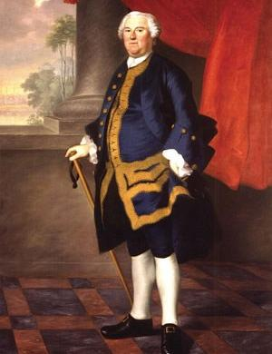
New Hampshire
In 1679, King Charles II granted New Hampshire its own charter.
In 1686, New Hampshire and Massachusetts were reunited under the rule of one royally appointed governor*.
In 1691, New Hampshire was again granted its own charter.
While considered separate colonies, one governor ruled Massachusetts Bay and New Hampshire until 1741.
New Hampshire remained a royal colony under the 1691 charter until the American Revolution.
Appointed in 1741, Benning Wentworth served as New Hampshire’s first governor.
Notes:
*See the slide titled “Dominion of Mew England.”

Slide 45
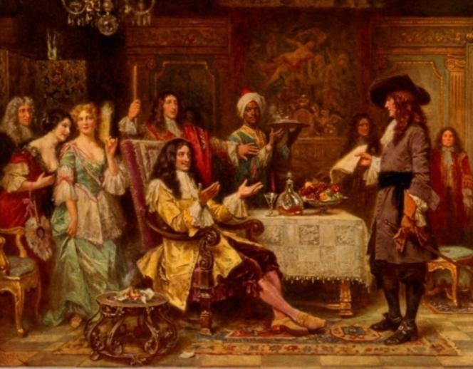
Pennsylvania
In 1664, England seized New Netherland from the Dutch.
In 1681, King Charles II granted a portion of territory to William Penn*.
The proprietary charter gave Penn the power to establish political organizations and a court system.
Penn, a devoted Quaker, used that power to create what he called a “holy experiment.”
Although it often is assumed the colony was named after William Penn, it was named in honor of his father. The king insisted that “Penn” be attached to the proposed name of “Sylvania.”
Notes:
When his father died, William Penn inherited his family’s fortune which included a claim on the English crown for £16,000. He convinced the king to grant him land in America in exchange for the money he was owed.

Slide 46
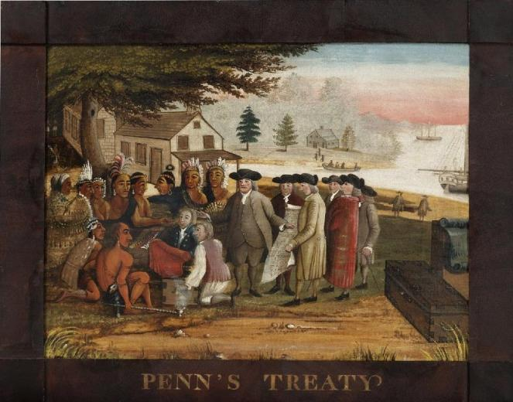
Penn’s “Holy Experiment”
Penn’s Government:
guaranteed political and religious freedom;
Allowed for an elected assembly;
provided jury trials for those accused of a crime;
made education available to all children.
Despite his charter, Penn paid local American Indians fairly for the use of their land.
He even learned the Indian’s language, so he could negotiate with them directly.
According to legend, Penn signed a peace treaty with the Leni Lenape Indians beneath an old elm tree in what is now the Fishtown section of Philadelphia.

Slide 47
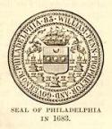
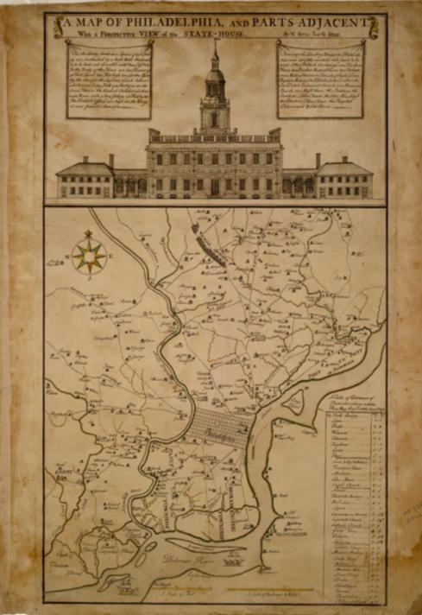
Philadelphia 1682
Penn also planned a city on banks of the Delaware River.
He named the city Philadelphia (the city of brotherly love).
It was to be a center for trade and government.
Penn wanted to create space between houses to help to curb disease and to maintain fire safety.
To achieve this, city streets were planned a grid pattern.

Slide 48
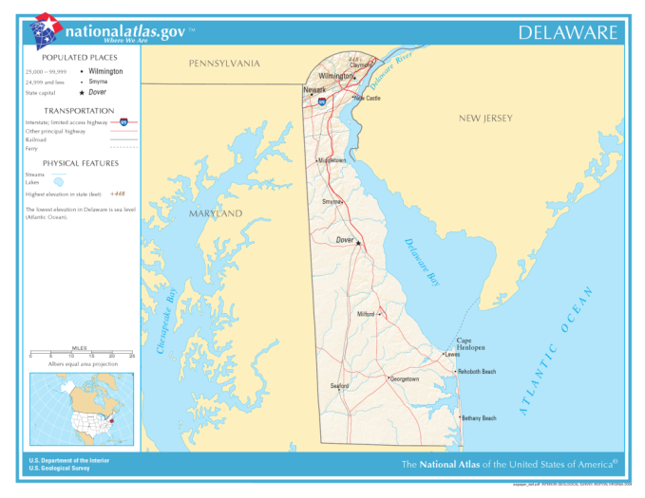
Delaware
After seizing New Amsterdam from the Dutch, the English sent Sir Robert Carr to capture New Amstel.
The settlement was conquered in the fall of 1664 and renamed New Castle.
For the next 22 years, the area that would later become Delaware was governed as part of the New York Colony.

Slide 49
Delaware
In 1682, William Penn convinced the Duke of York to grant the land to him.
The area became known as The Three Lower Counties on the Delaware River.“
At first, Pennsylvania and the Lower Counties shared both a governor and an assembly.
However, representatives from both regions soon petitioned for, and were granted, separate assemblies.
Delaware gave William Penn’s Province of Pennsylvania an outlet to the Atlantic Ocean.

Slide 50
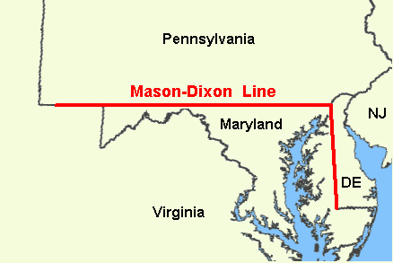
Delaware
Meanwhile, Lord Baltimore of Maryland also claimed the area on the lower Delaware.
A dispute between the heirs of both men continued until Delaware's boundaries were surveyed in 1763.
It was not until 1776 that Delaware established a government entirely independent from that of Pennsylvania.
The Mason-Dixon line was named for the 2 Englishmen that surveyed the land. It resolved the border dispute between Pennsylvania and Maryland.

Slide 51
Dominion of New England 1686 - 1689
Background Information
As late as 1680, some colonies in New England continued to pose a threat to English authority despite reforms:
Massachusetts Bay was extremely intolerant of non-Puritans;
New Haven had harbored three of the judges responsible for the execution of King Charles I.
The Plymouth Colony had never operated under a formal charter.
At the same time, the government wanted to bring down the cost of administration, raise more tax revenue, and tighten their control over trade.
To address these issues, charters were revoked and northern colonies were united under the authority of a single governor*.
In May 1686, Massachusetts Bay, Plymouth, New Hampshire, and Maine became the Dominion of New England**.
Notes:
*This process began under King Charles II and was completed by his successor, James II.
**By September, Rhode Island and Connecticut were added and in 1688, New York and East and West Jersey were added.

Slide 52
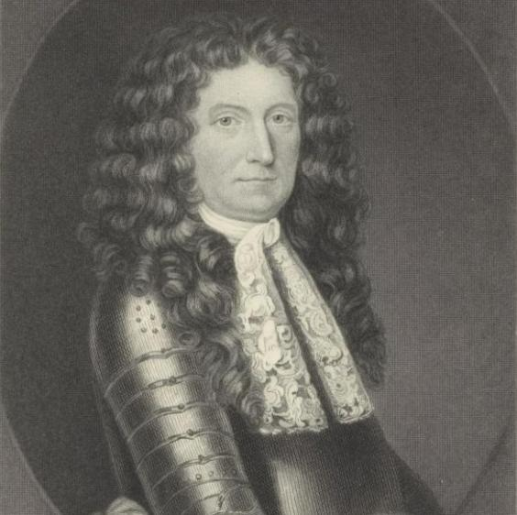
Dominion of New England
Background Information
In late 1686, Sir Edmund Andros became governor:
Andros enforced tax laws and religious tolerance.
He also enacted laws restricting the power of popular assemblies and reformed the land-grant system.
Andros was extremely unpopular.
In addition, the Dominion was simply too large for one governor to manage.
Sir Edmund Andros (above) was the second governor of the Dominion of New England.

Slide 53
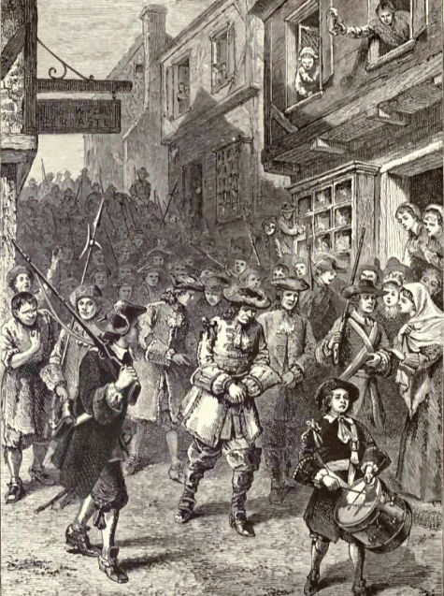
The Glorious Revolution
Background Information
In 1688, Parliament ran King James II out of London.
William and Mary were invited to rule under certain conditions*.
When the news reached Boston, colonists staged an uprising.
Uprisings in Maryland and New York soon followed.
Parliament responded by dissolving the Dominion and restoring colonial charters.
In Boston, colonists arrested and other dominion officials.
Notes:
*They had to agree to rule in partnership with Parliament and accept laws limiting their power. They were forced to sign the English Bill of Rights. England had become a Constitutional Monarchy.

Slide 54
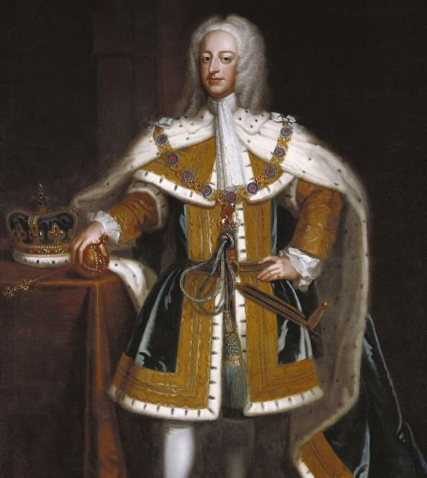
Georgia
In 1730, a group of London humanitarians known as the “Georgia Trustees” proposed an idea:
They wanted to establish a colony where hardworking Englishmen imprisoned for debt could get a fresh start.
At the same time, South Carolinians wanted a buffer between themselves and Spanish Florida.
The trustees were granted a charter in 1732.
Georgia, named for King George II, was the last of the English colonies.

Slide 55
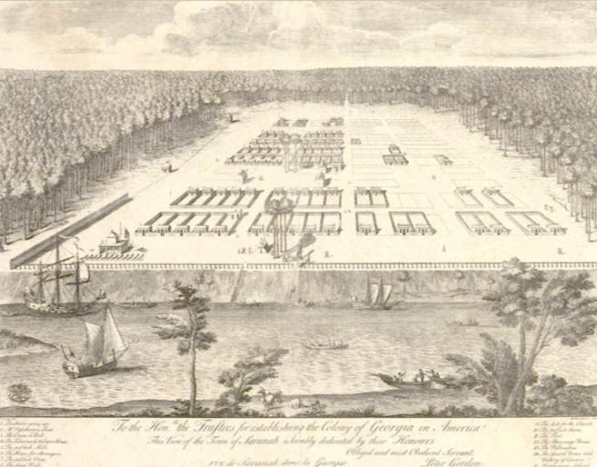
Georgia
Trustee James Oglethorpe accompanied the first group of Georgia settlers.
On February 12, 1733, Savannah was founded.
To promote equity, a strict plan for settlement was devised:
No more than 50 acre lots would be granted*;
Land could not be sold or inherited.
An 18th century sketch of Savannah.
Notes:
*Colonists who could afford to support themselves as well as indentured servants could request larger grants. However, the grants were still limited to fifty acre lots. One additional lot would be granted for each indentured servant the grantee supported. Servants were also eligible for a land grant once they completed their term of service.

Slide 56
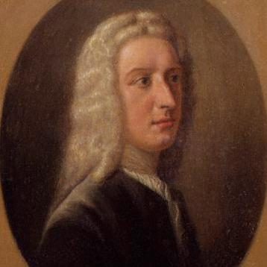
Georgia
Originally, liquor and slavery were outlawed in the colony.
Shrewd settlers soon found ways around the laws.
Georgia’s economy began to resemble South Carolina’s; based on large land holdings and slave labor.
Disappointed trustees surrendered their charter one year before it was set to expire.
Georgia became a royal colony in 1752.
Oglethorpe thought Georgia’s main exports would be wine, olive oil and silk. Like South Carolina, however, the climate was better suited for rice cultivation.
END

