Slide 1
The Boston Massacre

Slide 2
Central Historical Question
What happened in Boston
on March 5, 1770?

Slide 3
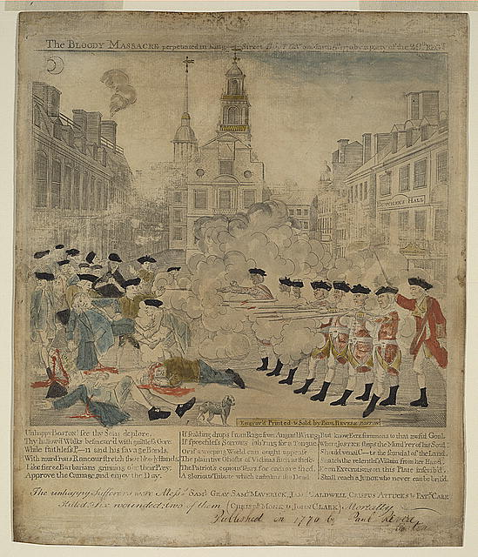
Image 1
Notes:
Image retrieved from the Library of Congress at https://www.loc.gov/item/2008661777/

Slide 4
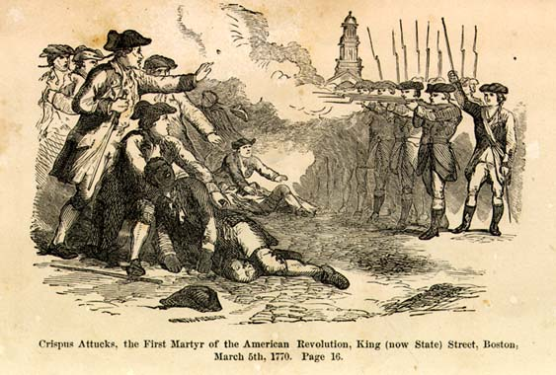
Image 2
Notes:
Image retrieved from the Library of Congress at https://www.loc.gov/item/cph26998/

Slide 5
Image 1 & Image 2
Paul Revere, March 28, 1770
The Bloody Massacre
Perpetrated in King Street on March 5th 1770 by a party of the 29th Regiment
William Nell, 1855
The Colored Patriots of the American Revolution

