Slide 1
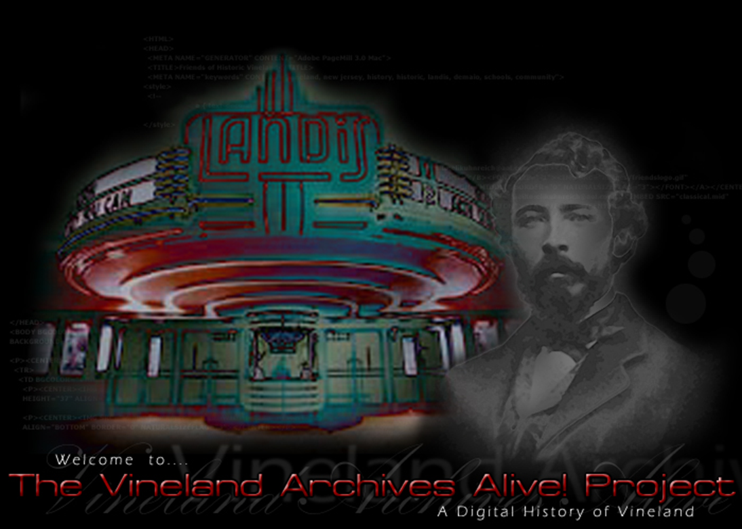
Archives Alive! Unit III: The History Vineland

Slide 2
Objectives
By the end of this section, you will be able to:
Identify historical sites, events and people related to the history of Vineland
Explain why some locations in New Jersey, such as Vineland, are more suited for settlement than others.
Summarize reasons why various groups, voluntarily and involuntarily, immigrated to Vineland, and describe the challenges they encountered.
Identify historical sites, events and people related to the history of Vineland

Slide 3
Word Wall
Charles K. Landis Lenni-Lenape
Richard D. Wood Uri Carruth
Dr. Thomas B. Welch Vineland’s First High School
Vineland’s Railroad System Siloam Cemetery
The Poultry and Egg Festival Founders Day
Gittone Stadium The Palace of Depression
The Landis Theatre Vineland Electric Plant

Slide 4
Origins
The first farmers in the Vineland area were the Lenni-Lenape, the Native-American tribe that inhabited southern New Jersey. They cleared pieces of land by burning underbrush and cutting down trees. They domesticated and grew corn, kidney and lima beans, pumpkins, artichoke, sunflowers and tobacco. Actual ownership of the land known as Vineland has had an interesting history. The land that makes us Vineland changed hands several times from the mid 1600’s until Charles K. Landis founded Vineland during the early 1860’s.
King Charles II of England gave the territory to his brother, the Duke of York, in 1664. The Duke of York gave the title to the land to Lord Berkeley and George Carteret on June 28, 1664, who named the huge tract of land Nova Cesarea or New Jersey. Eventually, David C. Wood purchased the western part of this area, which would become Vineland, roughly 16,000 acres. David then gave the title to the land to his brother Richard D. Wood. Most of these early settlers were uneducated, poor, and lived in log cabins with dirt or clay.

Slide 5
Origins
The land in the Vineland area, was then owned by a group of wealthy individuals: Judge L.Q.C Elmer, Charles E. Elmer, "the honorable" J.T. Nixon, J.M. Moore, J.W. Coombes, William Garrison, Richard D. Wood, and others. Without railroad access for the tract, they let the land lie fallow and desolate. The nearest railroad was the West Jersey Railroad, which ran a line from Camden to Glassboro, and then to Bridgeton. Consequently, with this situation and low levels of literacy and skilled labor among the few inhabitants, the Vineland area was virtually unutilized.
With the exceptions of a few trappers and those who make their living from lumber, the Vineland area was a neglected forest, void of any forms of civilization until the early 1860's. 9 Landis described it as being, "a wilderness of a forbidding aspect; no beautiful parks, but oak of second or third growth, pine and brush...the land was level, but with enough roll for drainage (9 feet per mile)...many miles were covered by small streams and swamps that needed to be drained.

Slide 6
The Founding of Vineland
The story of the founding of Vineland starts, oddly enough, in Hammonton, New Jersey. In 1857, a man named Charles K. Landis bought 5,000 acres of land on the newly opened railway that ran from Camden to Atlantic City. 15 Landis, whose last name was an Anglicized version of Landi, was born in Philadelphia on March 16, 1833, son to Michael G. Landis, "who came from the hardy pioneer stock that entered Pennsylvania about the same time as William Penn.
Landis planned to build Hammonton as a colony, selling the land only to settlers, not other speculators. Landis encouraged fruit growing, introduced the New England model of education, forbid the sale of liquor, and built roads. Within three years, the colony of Hammonton was a stable town with over 2,000 inhabitants. The colony was very prosperous, producing more food than needed and selling large amounts of produce to Philadelphia and New York City. While successful, Hammonton must not have quenched Landis' thirst for colonization. He felt that he needed to try his grand plans for a colony on an even larger scale to accomplish his dream.

Slide 7
The Founding of Vineland
Landis set out, looking for more land to colonize. He visited several places in North Jersey and the Western U.S., examining markets, the climate, and soil. He wished to find land that could accommodate the growing of fruit trees because they would require less capital investment than grains and yield higher profits. He again decided to locate his colony in South Jersey because of the fertile soil (sandy and clay loam), temperate climate, long growing season, and close proximity to Philadelphia.
Landis learned of a new railroad that was built from Glassboro to Millville. Landis also learned that the railroad's main promoter and developer, Richard D. Wood. Mr. Wood was a wealthy Philadelphia Quaker who owned between 18,000 - 20,000 acres of land along this railway. In July of 1861, Landis met Wood in Philadelphia and told him of his colonization plan. Wood was interested, so they agreed to travel by train to Millville to see the land and negotiate on a price. Wood settled on selling approximately 15,000 acres of the land to Landis at $7.00 per acre, without interest, for 3 1/2 years. Landis would pay Wood a percentage on each land sale until he had paid off his debt to Wood. Wood would also retain the timber rights to the land until it was bought by a third party.

Slide 8
The Founding of Vineland
On August 8, 1861, Vineland was launched. Landis had several conditions that would govern the sale of his land and the building of the colony such as:
1. A house had to be erected on all land sold within one year.
2. At least 2 1/2 acres of land had to be cleared and cultivated each year.
3. Houses would have to be placed at least 75 feet from the road on the outskirts of town, 20 feet within the town
4. Shade tress had to be planted so that they would draw birds that would help control the insect population of his colony.

Slide 9
The Founding of Vineland
Gradually, Landis sold many land blocks to settlers, most of who came from New England. By 1864 the town had remarkably grown to roughly 650 houses and 4,000 inhabitants. In addition, 1864 proved to be an important year in the history of Vineland. First, the town experienced unprecedented growth. Second, a horrible drought destroyed the year's crops, except for a record crop of turnips. Lastly, the town decided to buy exemptions for the 93 men who had been drafted into the Union army. Because of this, many former soldiers and draft dodgers came to Vineland.
Landis was overjoyed at the prosperity of his colony, but was dismayed at the fact that most of the new settlers were not farmers and were moving into the center of town. He stopped advertising the in-town lots and only advertised the farm lands surrounding the center of town, as Landis wanted to draw more experienced farmers to the area.
The farmers who were here at the time were all from New England and New York. Their farms were very successful, as it was reported in 1865 that one day's labor on Vineland's soil would accomplish twice as much as the same labor on their previous New England or New York farms.

Slide 10
Reflection #1
What were some of the conditions Charles K. Landis placed on the sale and development of his land?

Slide 11
The Murder Trial of Charles K. Landis
In 1875, Landis shot Uri Carruth in the back of the head. Uri Carruth was the editor and publisher of the Vineland Independent newspaper. Carruth had published a rumor about Landis wanting to commit his wife Clara to an insane asylum. Carruth hung on for seven months before dying from his wounds. B. Frank Ladd, who was present at the newspaper office when the shooting took place, was among witnesses called to testify. Ladd recalled that Landis exclaimed, "I've killed him. I am sorry, I was obliged to do it. I did it in the case of God and humility. Oh, my poor, crazy wife.”
After 21 days of court proceedings, the trial ended with a bizarre twist. Landis was acquitted based on temporary insanity, and many newspapers along the Eastern Seaboard voiced their outrage. Others wondered why Landis had been insane during the shooting but was now fit to walk the streets."'Twas true, I murdered Carruth most foully, but just at that particular moment I was insane," said Landis at the time. When Landis died in 1900, his obituary made no mention of the once-famous trial.

Slide 12
Vineland as an Agricultural Center
Mr. Landis noted that the sandy loam soil conditions were ideal for the production of grape. He promoted his idea by asking Italian immigrants who had this knowledge of grape production to come to this area (New Italy). He offered them 20 acres of land, which they had to clear and farm for the growing of grapes. This migration took place in the late 1800's. In 1882, Dr. Thomas B. Welch and Harry Upham formed a partnership for the manufacture and sale of unfermented wine. This partnership started the company called "Welch's Grape Juice". The company lasted only a few years and later moved to western N. Y. State. The Italian immigrants discovered that the land in Vineland was more suited for the production of vegetables. They began to produce sweet potatoes, pickles, peppers, black berries and strawberries.
In the South Vineland area, they began a more intensified farming of early vegetables. Such examples were early lettuce, carrots, beets, parsley, cabbage and many other varieties. The farmer hauled his produce to the local freight station to be shipped to the commission houses in New York and Philadelphia. The freight stations were located in Vineland, Bridgeton, Rosenhayn and Norma. In the 1920's, trucks became a more practical way of shipping produce to local markets. The local buyers purchased their own trucks and began to pick up produce at the farms. This was more convenient for the grower. It eliminated the long haul to the freight station by horse and wagon. Thus the farmer was able to remain at home and take care of business on the farm.

Slide 13
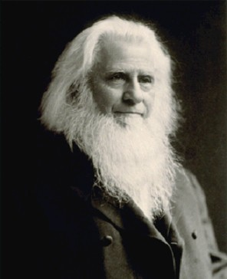
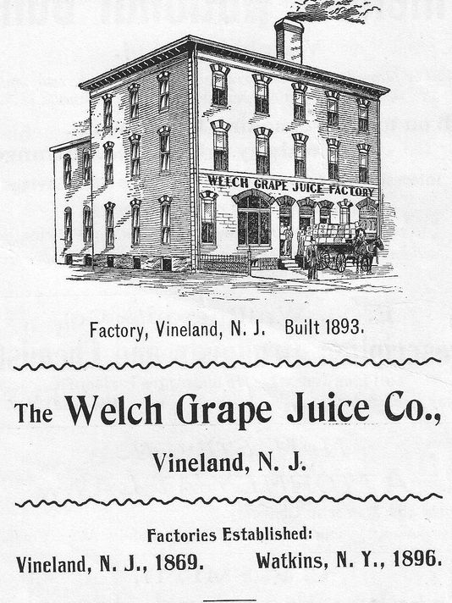
Thomas Bramwell Welch
Thomas Bramwell Welch (December 31, 1825 – December 29, 1903) was a British–American minister and dentist. He pioneered the use of pasteurization as a means of preventing of the fermentation of grape juice. He persuaded local churches to adopt this non-alcoholic "wine" for use in Holy Communion, calling it "Dr. Welch's Unfermented Wine.“ After years of working in Vineland, a larger grape area was needed so in 1897 the company was moved from Vineland to the Chautauqua and Erie grape belt where it is still a leading industry. Now the company has branches all over the country in various regions ranging from the North East to the Mid West and has expanded its horizons to include jam and jellies, tomato juices and various other juices and fruit products that can be found in any grocery store.

Slide 14
Vineland as an Agricultural Center
On April 30, 1930, a group of South Vineland growers formed a committee to begin a produce auction in Vineland. They met with the officials from Landis Township and obtained a gravel pit on north main road to be used as a produce auction market. It was located along the side of the main avenue fire hall near oak road. Five acres was given to the board by the Landis Township Committee and a 99 year lease was prepared by the committee to be renewed every seven years for one dollar. The first auction was held on May 21, 1931 at 12:00 p.m. Circulars were mailed to all farmers and buyers advising them of the date and time of the sale. The Franklin growers produce association asked permission to use the Vineland auction to sell their produce at a cost of one cent per package.
From 1969 to 1979 all but three auctions closed. Swedesboro, Landisville (no auction), Hightstown and Vineland auctions are still open. At the present time, there are three operating in New Jersey. The Vineland Produce Auction accounts for more than 95% of auction sales in the entire state.0 quarts. The Vineland Auction owns 40 acres of land, has 140,000 square feet of loading docks and handles 60 different commodities. The auction operates 34 weeks as an auction and is open year round for supplies and direct sales. About 40% of our business is done on a direct sales program and 60 % is auction sales. We have 550 active members and handle most of the fresh produce produced in the six southern counties of the state. Our average farm is 75 to 100 acres of intense farming and 100 % irrigation and also described as a family farm.

Slide 15
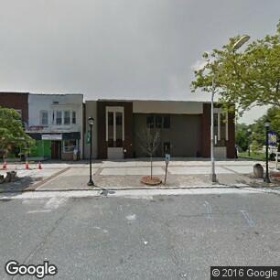
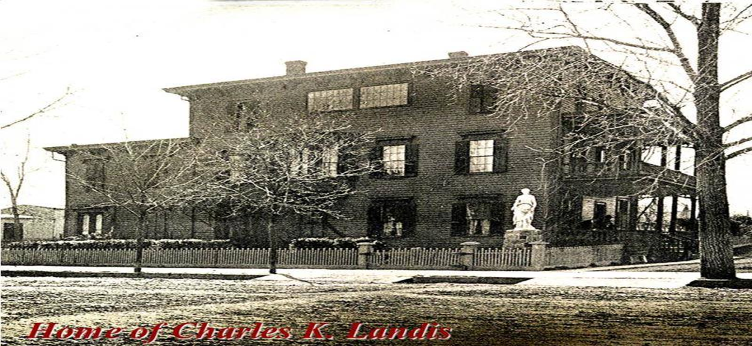
Vineland Then & Now
The city of Vineland has changed over the years. Some of the first buildings are still standing, and some are gone. Here is a photo gallery of Vineland showing current locations and what used to be there.
Today, the corner of Landis Ave. and the BLVD. is an office building, but over 150 years ago, this was the site of Charles K. Landis’ home
In the 1860s, Charles K. Landis had his home built on this corner. After Mr. Landis’ death, the home was turned into several businesses. It was torn down in the late 1960s.

Slide 16
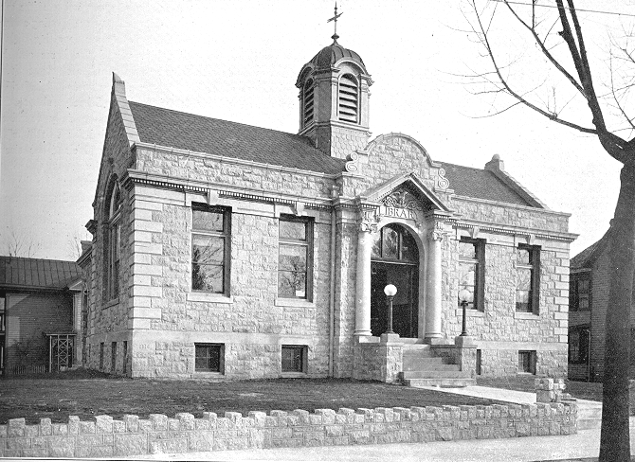
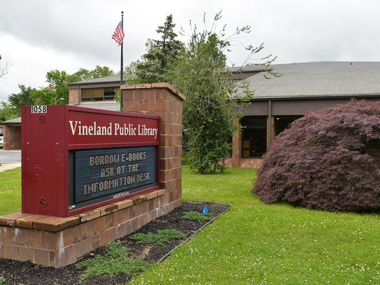
Vineland Then & Now
Original Vineland Public Library
Vineland Public Library Today

Slide 17
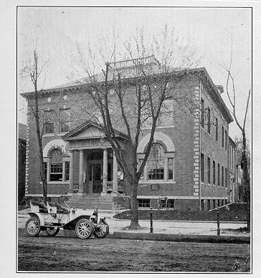
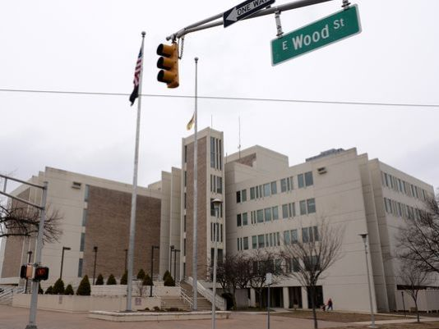
Vineland Then & Now
Original City Hall
City Hall Today

Slide 18
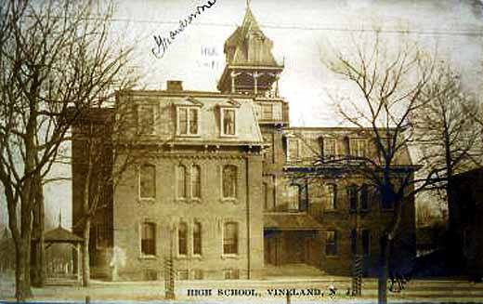
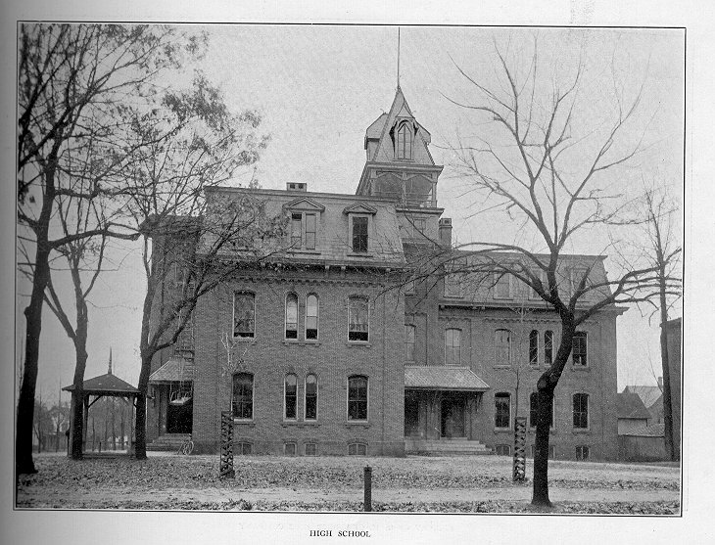
Vineland Then & Now
This was Vineland’s first high school. The left side of this building was built in 1873. The rest of the building was built in the 1890s. This picture is from 1905. When Reber School was built, this became Central school and was an elementary school until the late 1950s. The building was torn down and for a brief time the lot was a playground for Reber School.

Slide 19
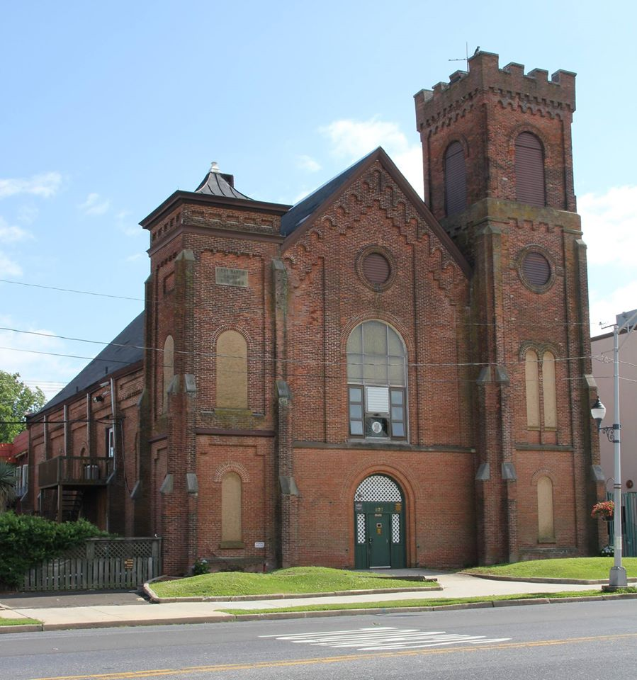
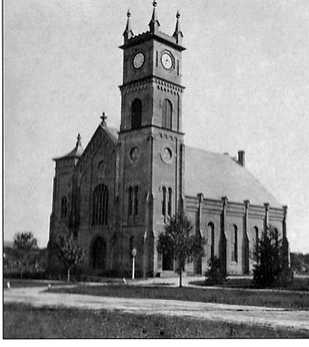
Vineland Then & Now
The First Baptist Church located on Landis Ave. as it appears today. This is across the street from Landis Theater.

Slide 20
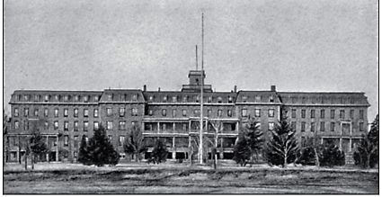
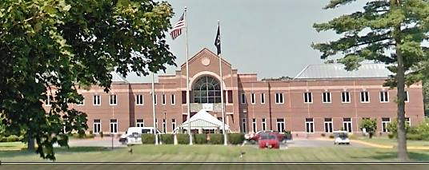
Vineland Then & Now
Vineland’s first Veteran’s Home. The center part of this structure was built in 1868 and served as Sacred Heart Seminary. The building later became the Veteran’s home and the left and right wings were added. This structure was torn down in the early 1990s.
In the early 1990s, the new Veteran’s Home was built. It is in the same location as the original. This is located on the boulevard near Park Ave.

Slide 21
Vineland’s Railroad System
Map of Railroads 1871

Slide 22
Vineland’s Railroad System
On the evening of the 7th of August, 1861 when Mr. Landis came down to “start Vineland,” that is, to drive the first stake, he requested the railroad conductor to let him out at an old road, which would take him direct to the Andrew Sharp farm, located at what is now the north-west corner of Park Avenue and Main Road. Landis told the conductor he had come down to start the settlement, and that unless he was let out at this place, he would have no way to get to the farm that night, without walking.
The business details were arranged, and on August 8, 1861, in the center of the tract was driven the first stake that marked the beginning of Vineland. This was in the center line of Landis Avenue and the Vineland Railroad System. Part of the events of the late 1860’s was an application for a railroad to connect Vineland and New York City by way of the Raritan and Delaware Bay Railroad. This was made it to the State Legislature in 1886 by C. K. Landis and others. The charter was granted in 1867.
The railroad failed to pay expenses and was finally sold in 1873 to Jay Gould to become part of the Central Railroad of New Jersey. Many localities were heavy financial losers, but the road was one of the important factors in the permanent prosperity of Vineland since it made possible the transportation of fruits and vegetables, and later a myriad of other products, to the New York area.

Slide 23
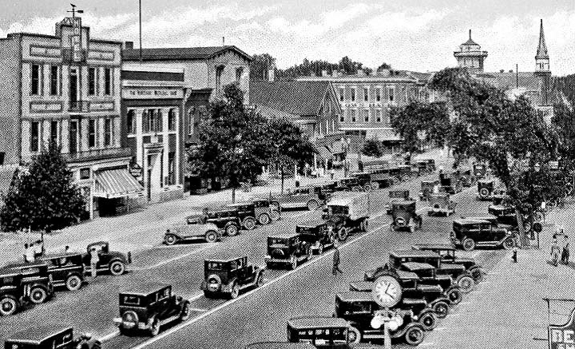
Landis Avenue Through The Years
Landis Avenue around 1900
Landis Avenue around 1930’s

Slide 24
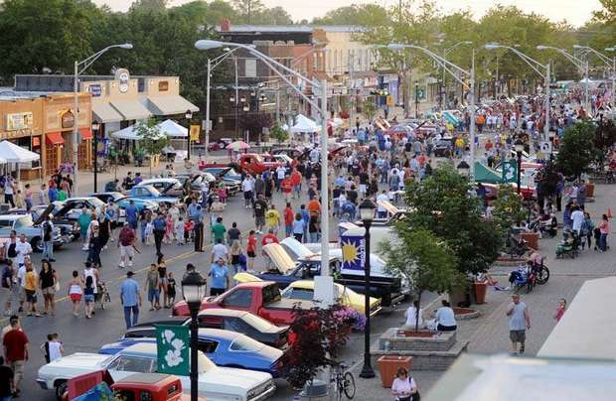
Landis Avenue Through The Years
Landis Avenue around 1960’s
Landis Avenue Today

Slide 25
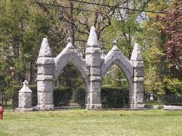
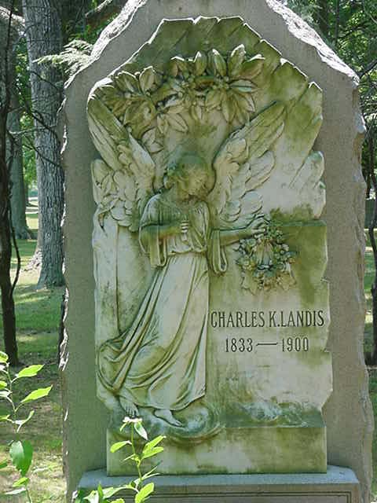
Siloam Cemetery: The “beautiful city of the dead”
Siloam Cemetery has derived its historic significance from the founding of Vineland, New Jersey in 1861. In 1864, Charles Kline Landis, the founder of Vineland, felt that his fast-growing town needed a place of mourning. A place, where he believed his citizens could be laid to rest. With this, Vineland was deeded a plot of 14.39 acres from Charles Kline Landis. Siloam’s first trustees were men of importance in the city, along with Charles K. Landis. In 1900, a beautiful arched granite entrance was constructed. A stone and iron fence was added in 1902. Today, Siloam cemetery still is recognized by many for its beauty and comfort with its surrounding architectures of its chapel and entrance, along with memorials of Vineland’s original citizens. Locally known, as the “beautiful city of the dead.”

Slide 26
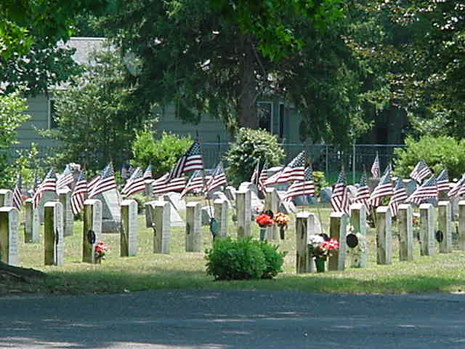
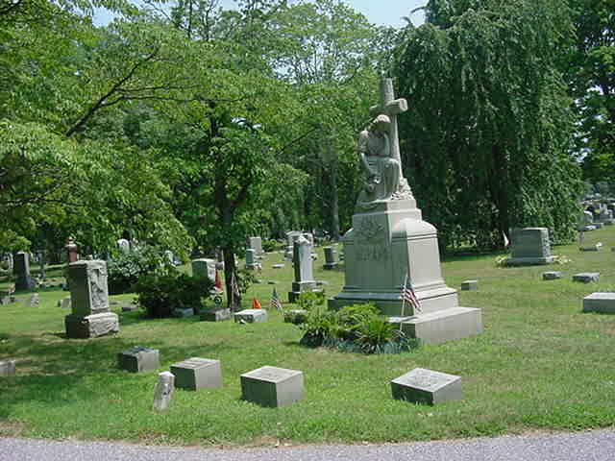
Siloam Cemetery: The “Beautiful City of the Dead”
As early as 1866 plans were abroad to construct a chapel that would stand in the center of the grounds in Siloam. Funding for this project however became rather expensive, and therefore it was not until 1916 when the association finally met and began to accept bids for the construction of the chapel. Walter L. Foulk, a local builder, was awarded the contract for $6,456.00. But by the end of its completion, costs had climbed up to $8,050.00. In December of 1918, the project of an “imposing chapel of granite and stained glass” was completed. From this date until the closing of the chapel in the 1980’s due to budgetary restrictions, the Siloam chapel was used for funeral services and private meditations.

Slide 27
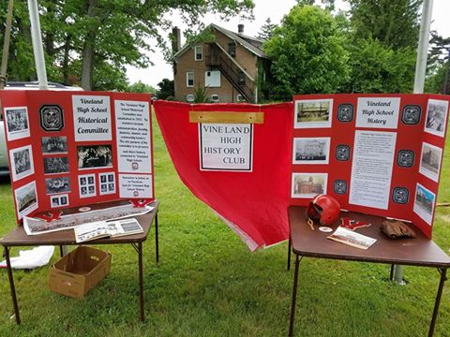
Founders Day
Each year, the Friends of Historic Vineland in association with The Downtown Improvement District, have sponsored a "Founder's Day" event for the benefit of the school children and the people of this area. The event has grown larger every year, with this one promising to be the biggest and best yet! In past years, the members of the Friends in conjunction with local Civil War Reenactors will host all of the third and fifth grade school children of the Vineland School District at the Landis Middle School with a living history event.

Slide 28
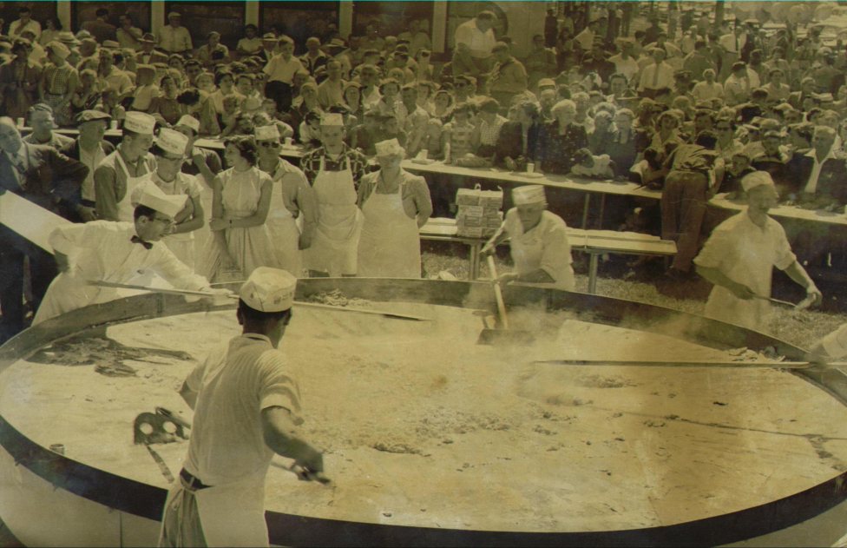
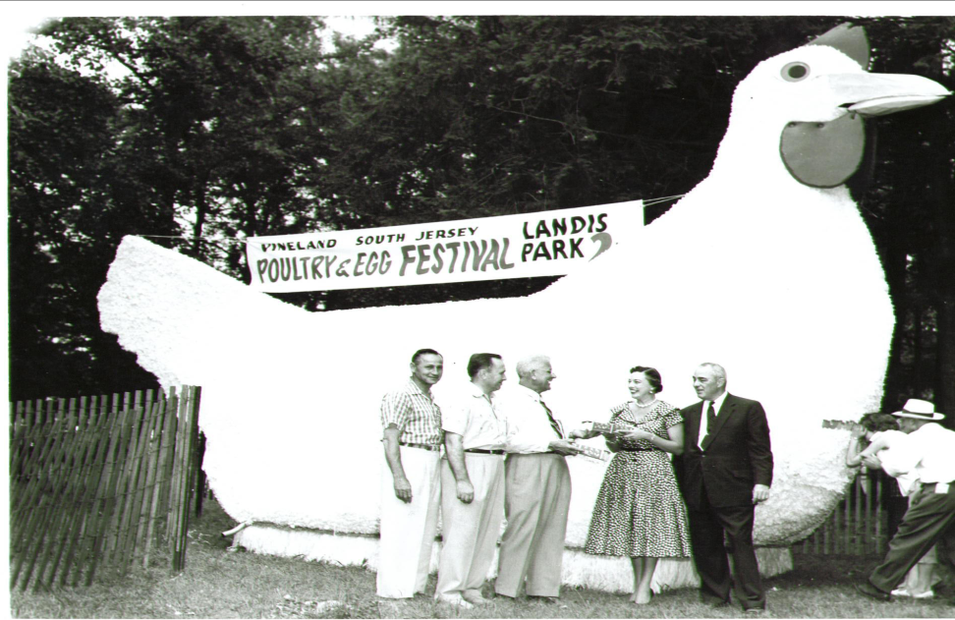
The Poultry and Egg Festival of Vineland: The Worlds Largest Frying Pan
In the late 1940s the poultry business took off in Vineland and people thought it would last forever. It flourished during the Depression and continued to flourish after World War II. Vineland became a leader in the industry and 90% of the Vineland population was involved in the egg and poultry industry in some way. As a celebration of Vineland's hard work and success and as a tribute to the industry, Vineland residents and industry leaders began hosting an annual Poultry and Egg Festival in June of 1954. Sadly, 1956 was the last year of the actual Poultry and Egg Festival as interest began to dwindle and Vineland slowly ceased to be "The Egg Basket of America”.

Slide 29
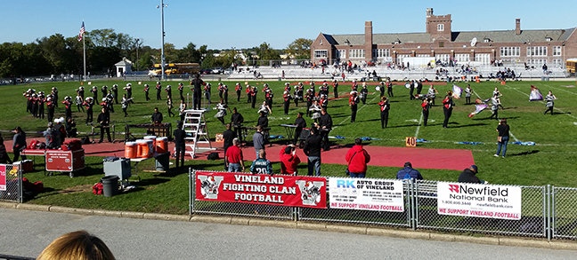
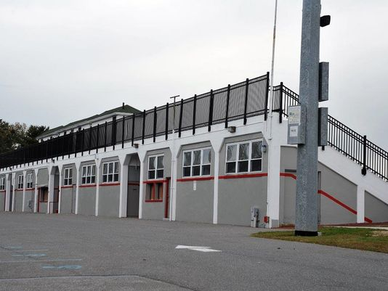
The History Gittone Stadium
Gittone Stadium was added to the Landis Intermediate School campus in 1935-36. It is still used today for high school football games, soccer matches and graduation ceremonies. The new high school opened in 1963 as the former Vineland High School was converted to a junior high school. Vineland High School, located on Chestnut Avenue, is a modern, campus-style institution and the athletic programs are now based there. Football games, however, are played at the Gittone Stadium on Friday evenings.

Slide 30
The History Gittone Stadium
1886: Vineland's first football game on Thanksgiving Day against the Porcillian Juniors and ends in a 62-0 loss.
1893: Vineland's first game against Millville High School.
1894: Vineland's first football season begins with informal matches at the Old Fair Grounds. According to Sports Historian, Bill Halkes, Vineland posts a 2 win 1 loss and 1 tie season. Vineland loses to Millville High School 12-0 and twice beating Keighly Shoe Factory, 12-0 and 6-0. The Vineland team tied the Millville YMCA, 0-0.
1928: New Vineland High School on West Landis Avenue is dedicated.
1929: October's stock market crash marks the beginning of the nation's Great Depression.
1930: Vineland wins New Jersey state championship. Football games are played at Landis Park.
1933: Gittone Field is dedicated at ceremonies prior to a game against Atlantic City which Vineland wins 14 - 0. Donations are essential to its construction since school funding is scarce. The field is named for Harry Gittone, father of long-time Vineland mayor John C. Gittone. 1935-36: The Works Progress Administration (WPA) is created by executive order by President Franklin D. Roosevelt. Improvements to the stadium are funded through the WPA.
1939: Vineland allows only one touchdown during this undefeated season, nearly winning a second state championship. The crown goes to our northern rival Garfield High School. The decision remains in dispute for some time.
1940-63: Gittone Stadium continues to grow in significance when the Vineland Senators semi-pro football team plays night games there. Fireworks on July 4th light up the stadium and deafen the ears. Each June, graduates march along the track to "Pomp and Circumstances" dressed in caps and gowns to receive their high school diplomas. High school sports programs expand. Fans rally, led by a marching band in crisp uniforms, enthusiastic cheerleaders, colorful guards and attractive majorettes. This is a time remembered by the locals as "the good old days". Some structural flaws in the stadium walls are worsened by hurricane winds with one collapse in 1951 and several close calls in 1954-55 when Hurricanes "Carol", "Edna", and "Hazel" visited Gittone Stadium.
1963: New high school opens serving grades nine through twelve. The former Vineland High School is converted to Landis Junior High School with grades seven, eight and nine. Gittone Stadium is still in use for Vineland High School football games and graduations.

Slide 31
The History Gittone Stadium
1976: Vineland High School adds grades nine and ten with the construction of a second school on the same campus.
1981: After completion of district reorganization, Landis Junior High becomes one of four middle school and is renamed Landis Intermediate School.
1982: The 50th anniversary of dedication of Gittone Stadium passes without fanfare, as reported by the local newspaper.
1990: Turkey Day football moved to Saturday when the NJSIAA (New Jersey State Interscholastic Athletic Association) changes post season playoff rules. The policy will eventually be amended and the Vineland vs. Millville game will be on Thanksgiving Day is again reinstated. (date not available)
1991: Landis School Historical Committee is formed with the goal of promoting the architectural and historical significance of the former Vineland High School.
1995: Landis School is entered on the National Register of Historic Places. The school auditorium is rededicated two years later after a complete restoration. The school historical committee will win a $5,000 grant from the National Trust for a comprehensive preservation plan for the building.
1999: In response to a new trend in high school sports, Friday night football, Vineland's Mayor announces formation of the Committee to Light Gittone Stadium. At a press conference, the mayor states, " The committee believes that the addition of lighting to the stadium complex will be a source of great pride to all Vinelanders, and will also provide the Vineland School system additional flexibility for school activities." At the same time, Landis School principal announces his interest in adding the stadium to The National Register and using it for Landis School events.
2000: Engineering study is commissioned by Vineland Public Schools to evaluate Gittone Stadium's structural worthiness. Public opposition to night games emerges based upon objections to traffic congestion on Monroe Street, noise, and inadequate parking areas. A local sports columnist calls for facility upgrades before lighting is considered. A member of the advisory board of the local newspaper praises Gittone Stadium in an editorial describing it as "a hallow shrine" and a local "gem".

Slide 32
Reflection #2
Choose and describe 6 events from the timeline related to the history of Gittone Stadium.

Slide 33
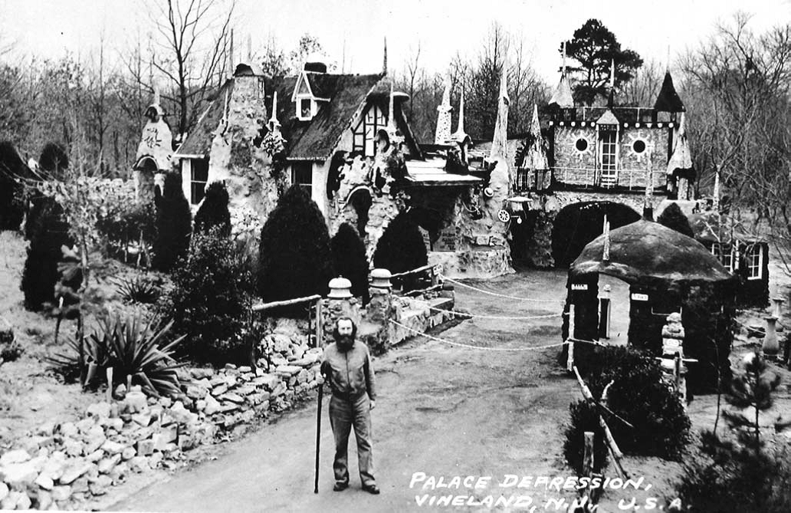
The Palace of Depression
The Palace Depression & George Daynor (1860 - 1964)
On Christmas Day 1932, George Daynor opened his Palace Depression to the public. For over two decades, the multicolored, eighteen-spire castle made from clay, concrete, and automobile parts commanded enormous press attention, fueled by the unabashed self-promotion of its creator. Billed as an antidote to the misery of the Great Depression, the unique Vineland structure became a popular stop off for tourists en route to Atlantic City. It was featured on Esso's Pictorial Map of New Jersey, and guest books signed by visitors are proof that as many as 250,000 tourists visited the Mill Road site during the 1930s and 40s.

Slide 34
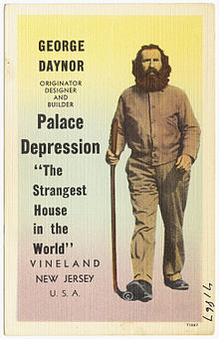
The Palace of Depression
George Daynor was a publicity hog and claimed to be "the most photographed man in the world." After Peter Weinberger was kidnapped on 4 July 1956 Daynor called the FBI and falsely reported that the kidnappers had visited the palace. The FBI followed the false claim and Daynor was imprisoned for a year.
George Daynor died bankrupt in 1964 at a reported 104 years old. After Daynor's death, a fire destroyed the Palace of Depression and Vineland razed it in 1969. As of 2001, a city restoration project to rebuild the Palace of Depression was in progress. Local companies and individuals were encouraged to volunteer materials and labor. Kevin Kirchner was leading the restoration effort. As of 2017 much of the Palace building itself has been restored and an adjacent Historical Center/Museum was also erected on the site.

Slide 35
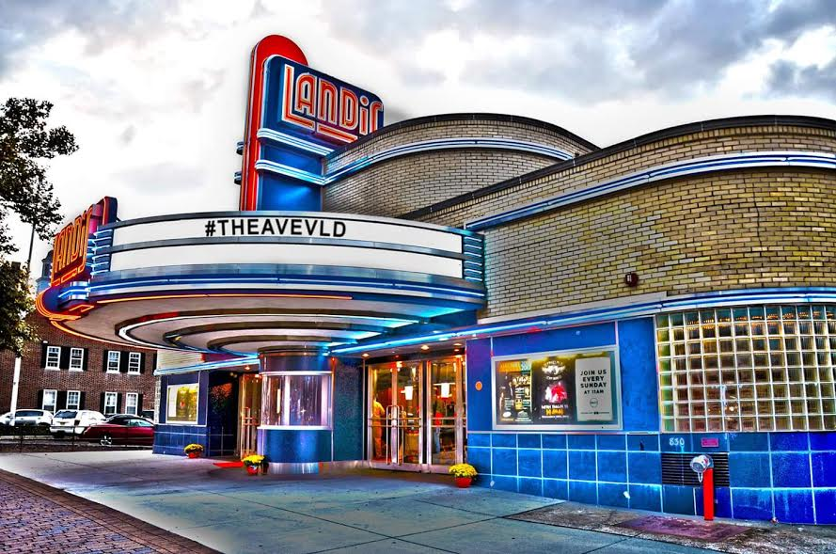
The Landis Theatre
The Landis Theatre opened on Friday evening, March 12, 1937 at 7:30 p.m. with a grand inaugural program that preceded the initial showing.
In 2001, the Landis Theatre is added to the National Register of Historic Places, but a myriad of safety and structural citations threaten to overshadow the designation. In, 2005, With the LTRA still not successful in attempts to revive the theater, the city acquires the building through the purchase of outstanding property tax liens. In October 2007, the redevelopment plan included reopening the Landis Theatre for performing arts, with the original auditorium having 650 seats and expanded stage facilities. On April 2, 2008, groundbreaking took place for the $6.5 million renovation. On October 22, 2009, a replica of the theatre’s original sign was installed above the marquee. The theatre reopened May 22, 2010 with a concert by Bernadette Peters.

Slide 36
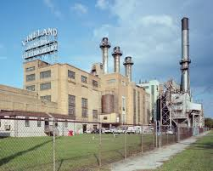
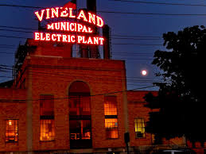
Vineland Municipal Electric Plant
Vineland Electric Utility was authorized by the Vineland Borough Council on August 8, 1899 because no private utility would supply Vineland with electricity. The plant was completed in 1900, or 100 years ago. It cost 25,000 dollars. Around 1930 the Board of Public Utility Commissioners of New Jersey allowed the Utility to serve the people in the Township, which included the area which today constitutes the entire City of Vineland. By 1998 the plant served approximately 18,000 customers, and had a value of more than 82 million dollars. It is the largest municipal electric utility in the state of New Jersey. In 1961, The City of Vineland Electric Utility with its 50,000 kw capacity, is the second largest municipally-owned generating station on the East coast. The Vineland Electric Utility will pursue to use all of the foresight and business judgment at our command to continue to provide for the growing needs of a prosperous city.

Slide 37
Reflection #3
Why is the Vineland Municipal Electric plant unique?

